Slide 1
SEED ROUND · OCTOBER 2026
MENTEIA
10 applied AI products. One platform. One team.
menteia.com

Slide 2
THE OPPORTUNITY
AI can now do expert work
01
02
03
Specialized work
Companies without an AI team
One platform, many industries
Serving, verifying, quoting, guiding: tasks that used to need experts.
Mid-sized companies in Mexico cannot build it on their own.
We build once and package by vertical.

Slide 3
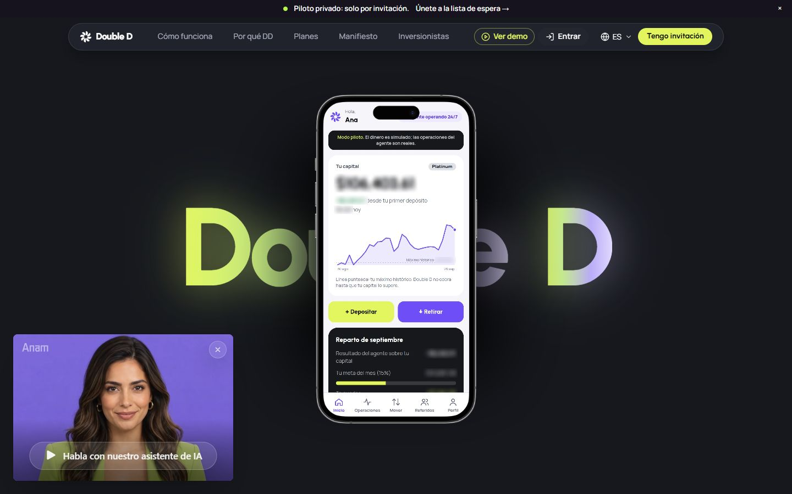
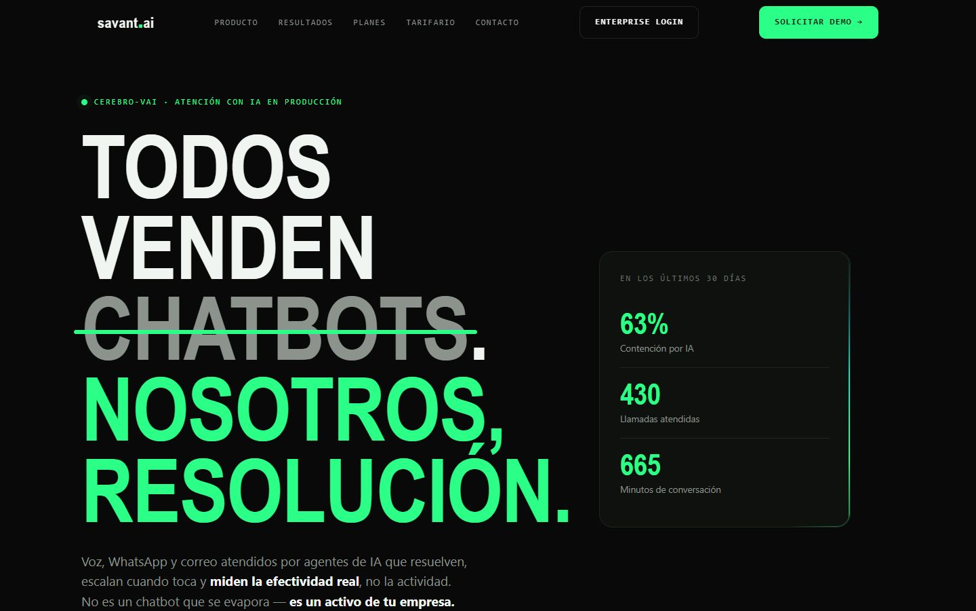
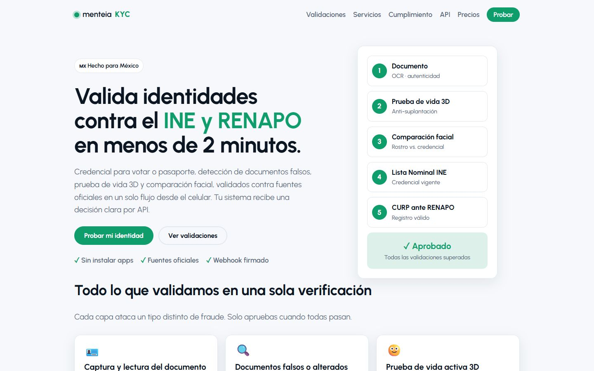
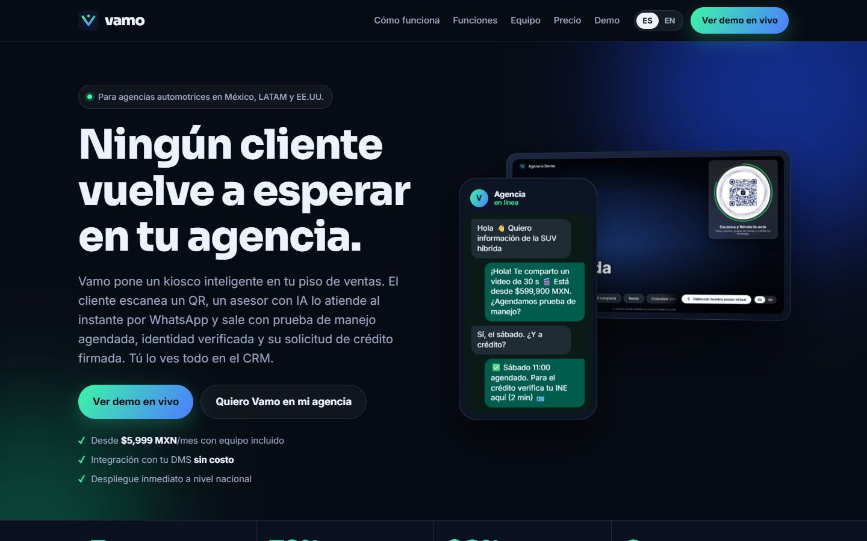
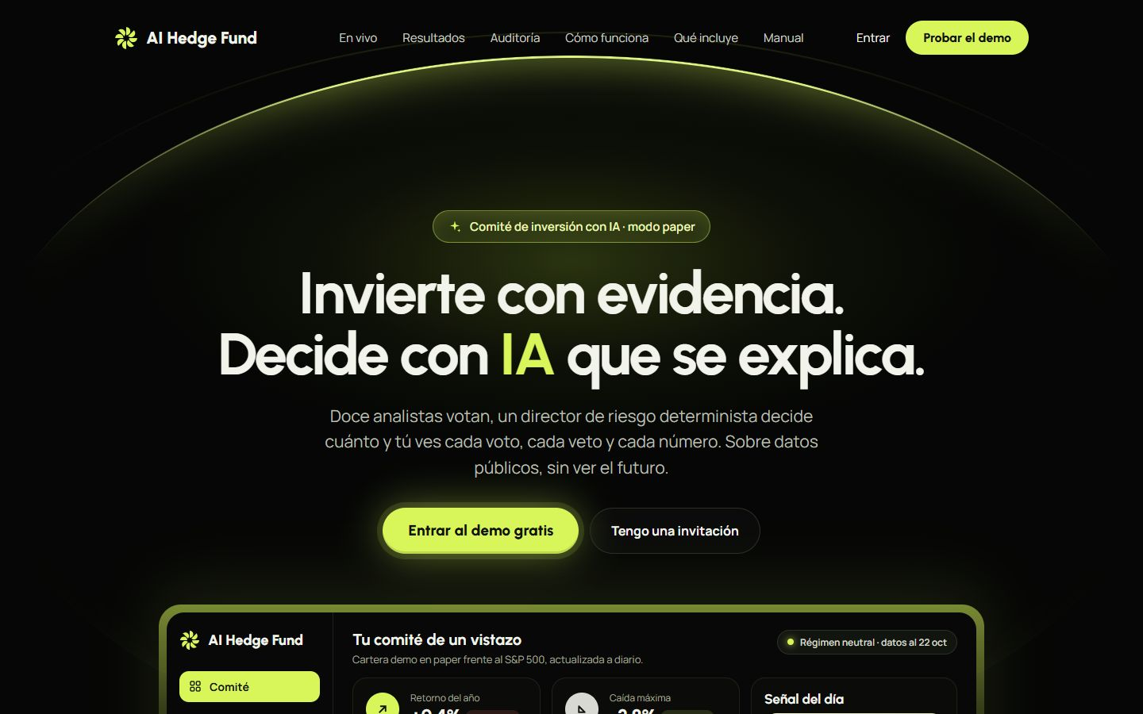
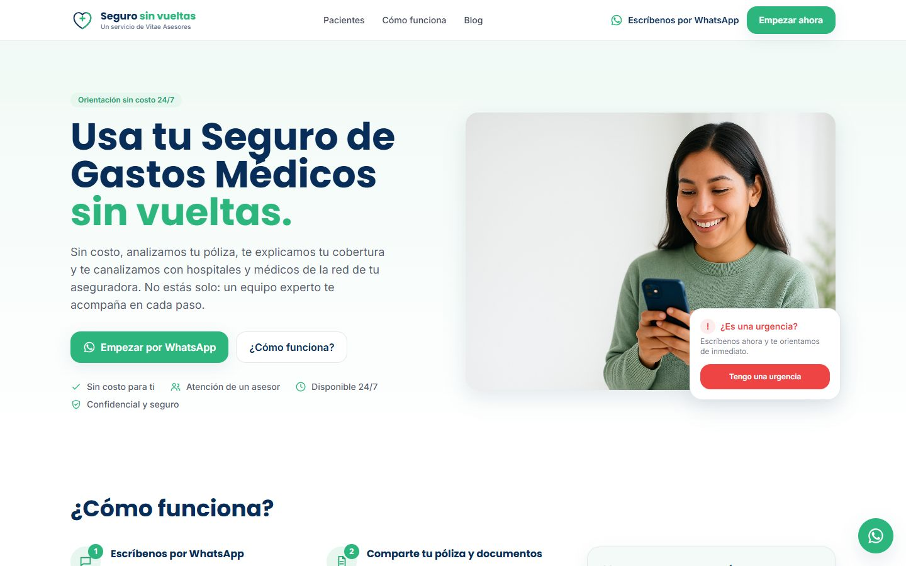
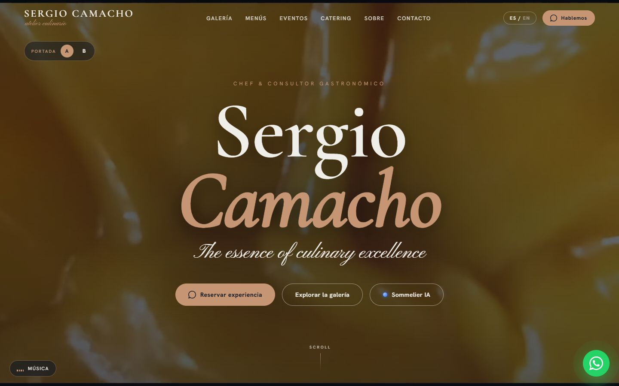
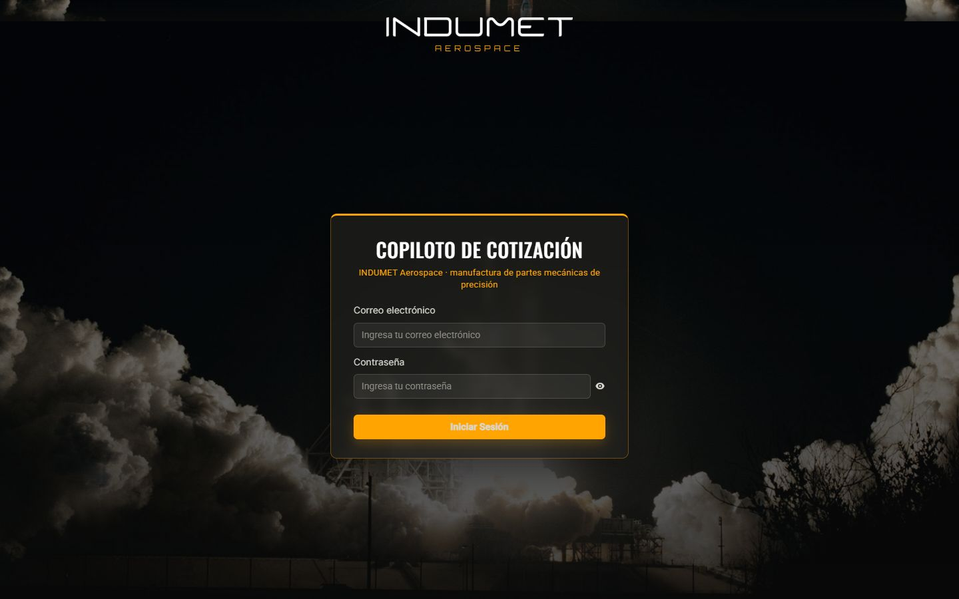
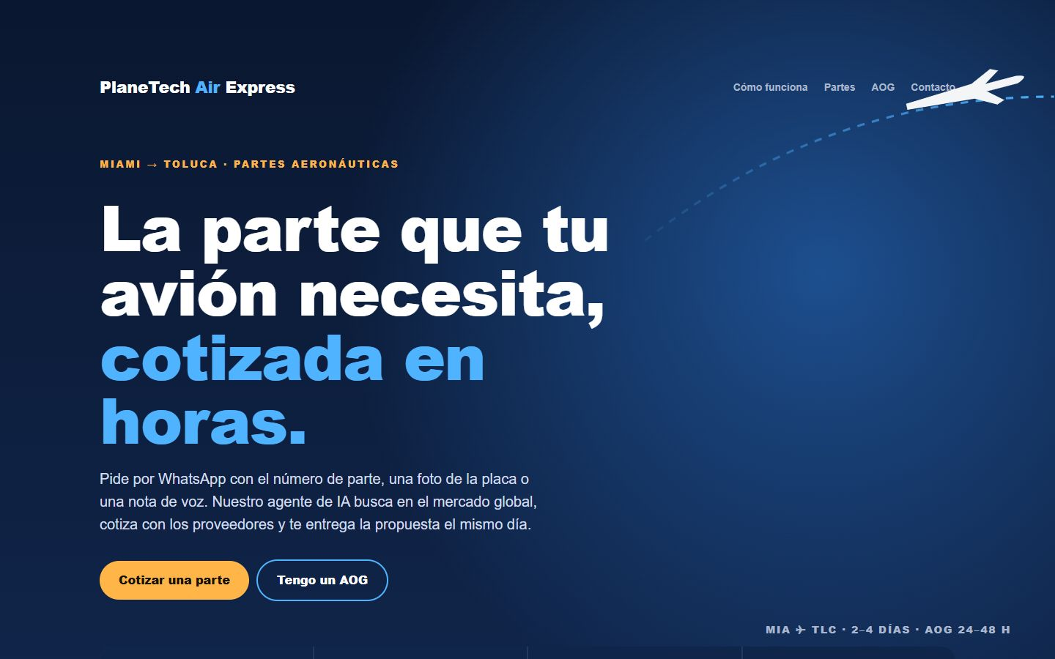
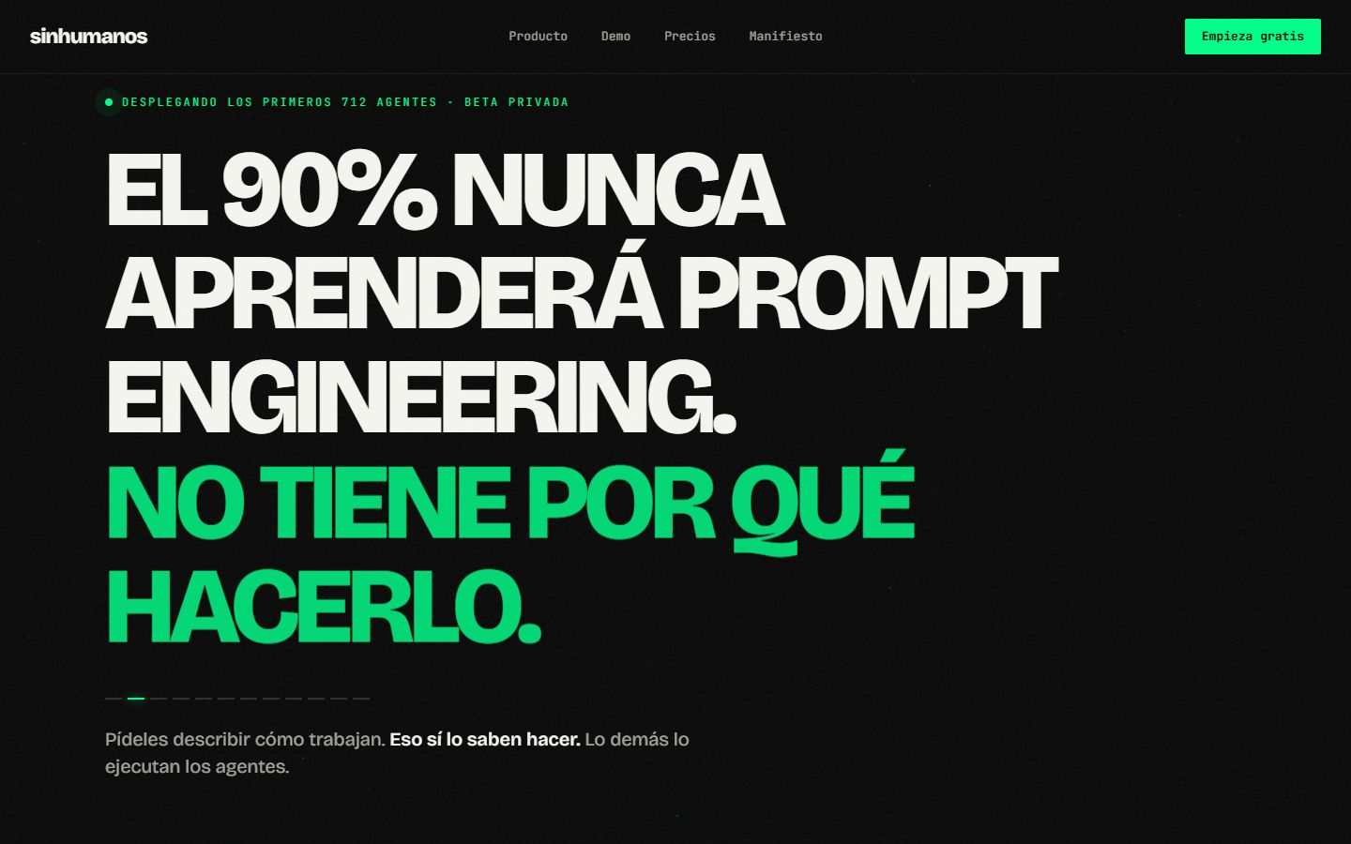
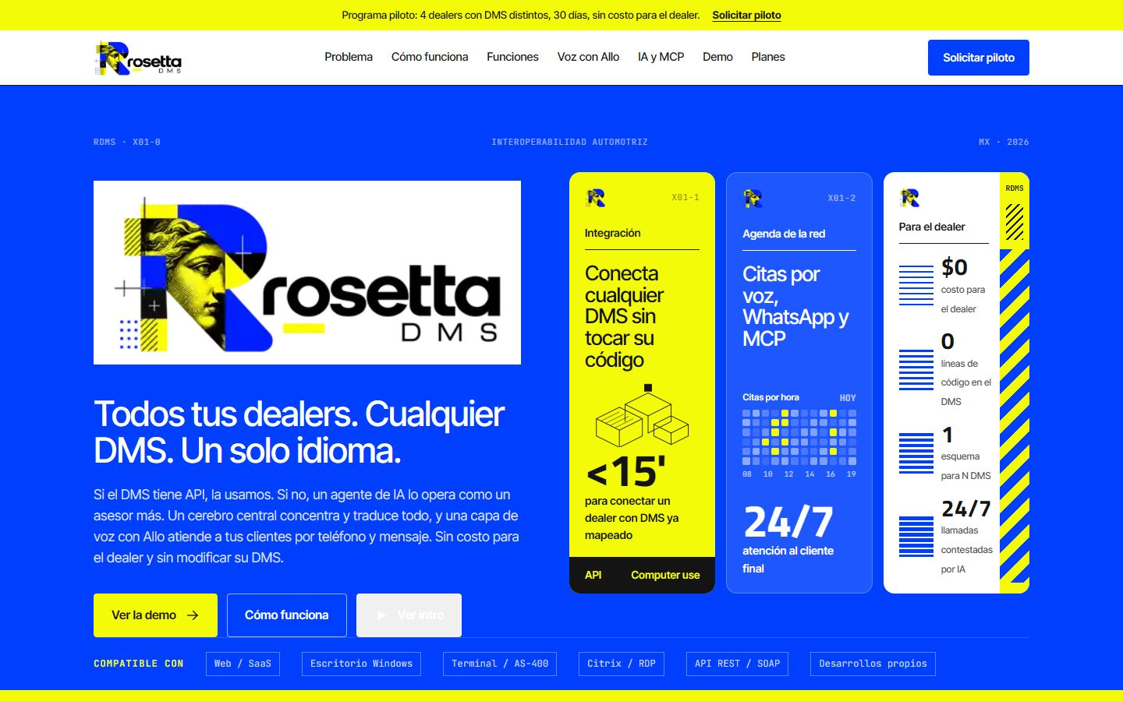
WHAT WE BUILD
Portfolio: 11 products in 7 industries
Doble D
SAVANT AI
Menteia KYC
Vamo
Menteia Hedge
Seguro Sin Vueltas
Pilot · ~60 users
Production · revenue
Production · revenue
Ford / Lincoln pilot
MVP
Pilot in production
Sommelier IA
Copiloto Aero
PlaneTech Air Express
SinHumanos
RosettaDMS
Showcase case
Production · INDUMET
Operating · ALE customer
Private beta · waitlist
Demo · seeking a pilot

Slide 4
TRACTION
Traction in under 6 months
10
4
US$3.2k
~60
products launched
with customers in production
monthly recurring revenue
users with real money (Doble D)
Customers and pilots: INXEL group (inXel, Jamachulel, XAP) · Ford and Lincoln · INDUMET · VITAE Asesores · Chef Sergio Camacho

Slide 5
ADVANTAGE
One shared platform
Identity
Conversational agents
Proprietary KYC engine: INE, RENAPO, biometrics.
WhatsApp, voice and email with human handoff.
Guardrails
Operations
Zero figures from the LLM; a human at every gate.
Shared infrastructure, monitoring and compliance.

Slide 6
FINANCIALS
24-month consolidated projection
US$6k
Monthly revenue today
US$288k
Monthly revenue at month 24
US$3.5M
ARR at month 24

Slide 7
THE OFFER
The round
US$4,800,000
USE OF FUNDS BY PRODUCT
SAVANT AI
14.6%
Doble D
13.7%
for 31.3% · 24 months of operation
Menteia KYC
12.7%
Vamo
10.8%
PRE-MONEY
US$10,550,000
Copiloto Aero
10.4%
POST-MONEY
US$15,350,000
Seguro Sin Vueltas
9%
PlaneTech Air Express
8.5%
TRANCHE 1
US$2,250,000 (12 months)
Menteia Hedge
7.9%
RosettaDMS
7.5%
Sommelier IA
4.8%

Slide 8
TEAM
Founding partners, 33.3% each
RH
VD
FD
Rafael Herrera
Vladimir Díaz
Francisco D'Angelo
CEO / CFO
CTO
Head of Legal and Compliance

Slide 9
Invest in Menteia
A portfolio of applied AI with real customers, a shared platform and optionality in every product.
Rafael Herrera · CEO / CFO
Vladimir Díaz · CTO
Francisco D'Angelo · Legal
menteia.com

