Slide 1
SEED ROUND · OCTOBER 2026
Doble D
Your money, working with artificial intelligence.
doblede.menteia.com
by MENTEIA
Notes:
Doble D: Investment platform where AI agents trade 24/7 under strict risk limits, with every trade visible to the client.

Slide 2
THE PROBLEM
Investing is still for the few
01
02
03
1% invests
Institutional-only strategies
Opaque apps
Of 22 M open investment accounts in Mexico, most are empty.
Algorithms that trade 24/7 are a privilege of funds, not savers.
They show balances but don't explain what's done with your money or why.

Slide 3
THE SOLUTION
AI agents that invest for you, by the rules
01
02
03
04
05
Open your account
Deposit
The AI trades
You see everything
Win or don't pay
Invite, KYC and 2FA in minutes.
SPEI, card from US$5, or USDC.
Max 5% per trade, 10% exposed, no leverage.
Every trade and its reasoning, live.
Fees only on profits; 20% to the protection fund.

Slide 4
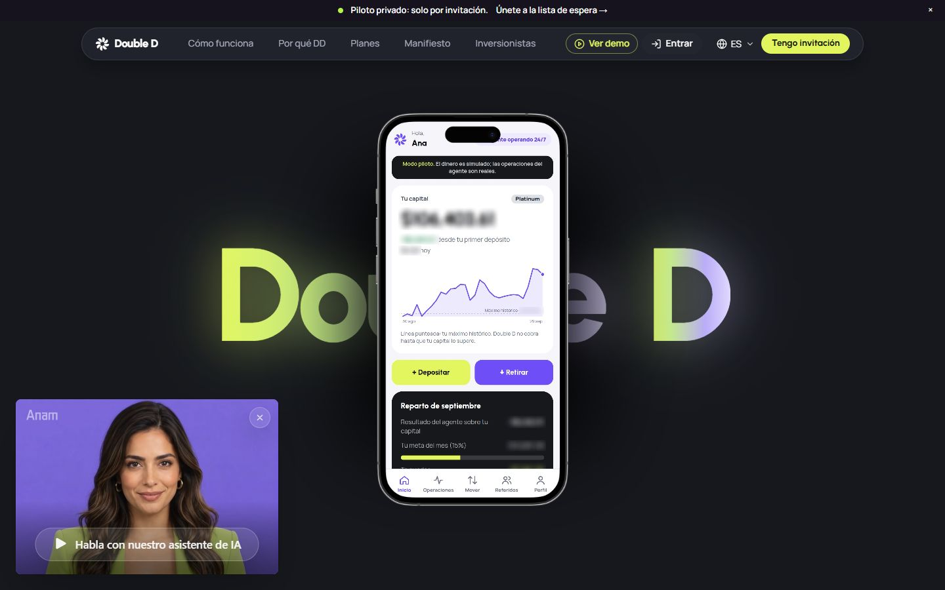
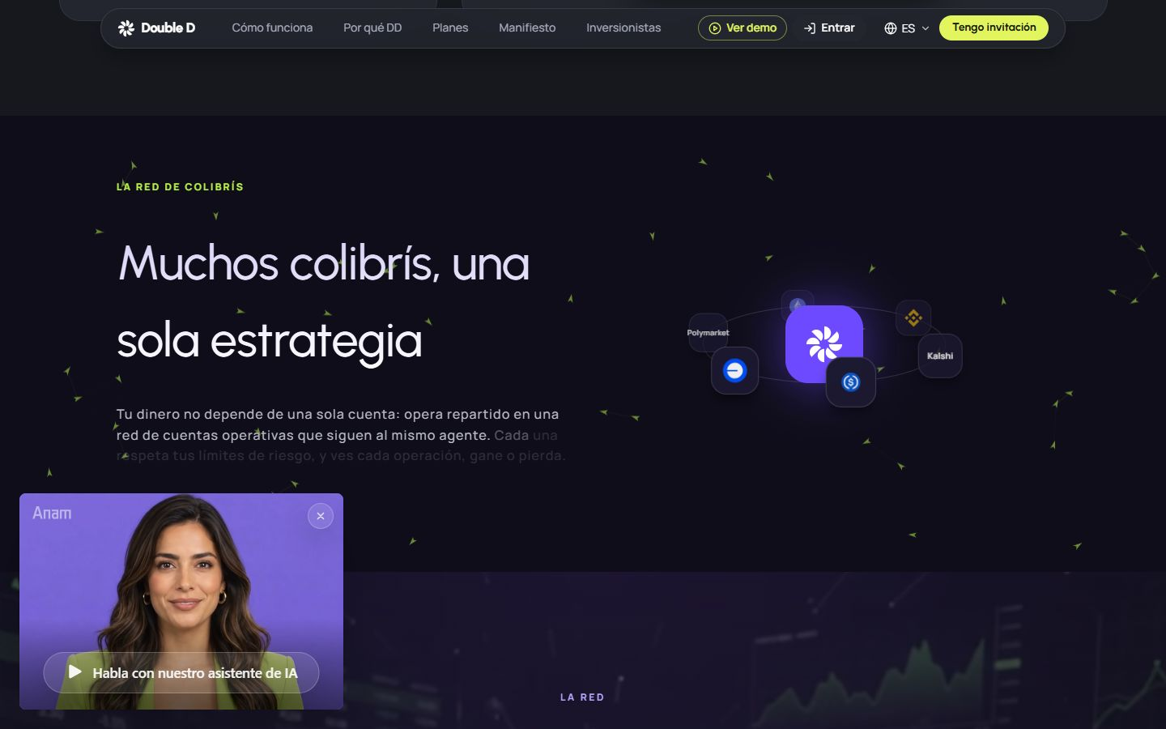
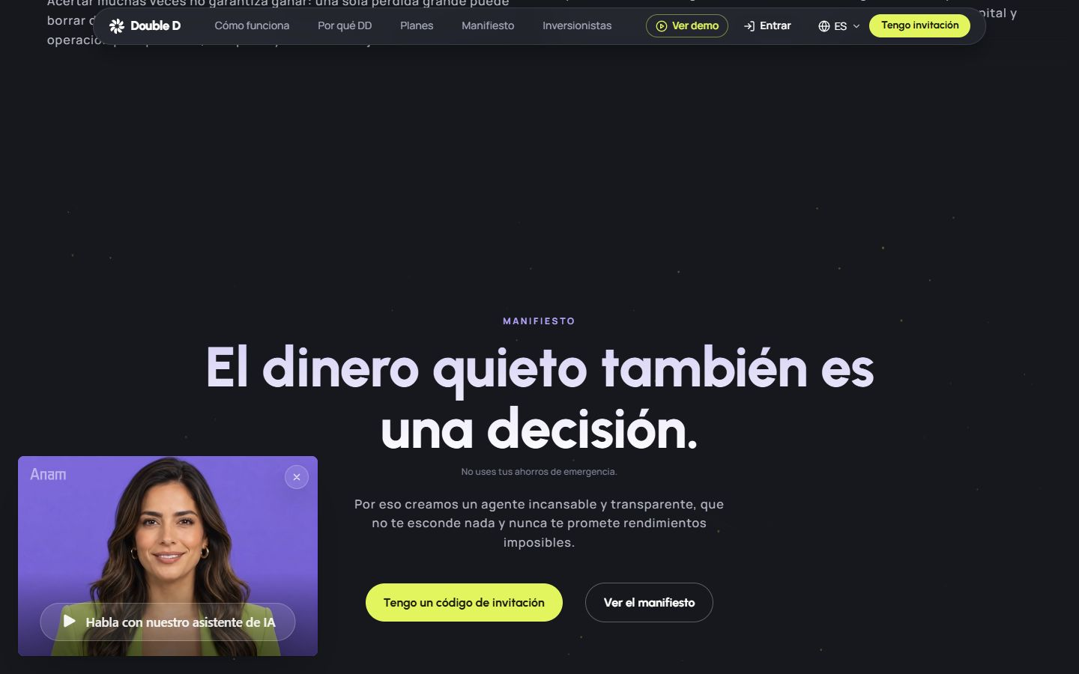
DOBLEDE.MENTEIA.COM
The product, on screen

Slide 5
WHY WE WIN
Risk with rules, full transparency
Programmed risk
Radical transparency
Hard limits the agent cannot break.
Log and reasoning for every trade.
Aligned incentives
In-house infrastructure
Performance fee with high-water mark.
Menteia's agent fleet and KYC: low marginal cost.

Slide 6
MARKET
3 million investors who want more than CETES
TAM US$60M
TAM
3 M funded investors in Mexico × US$20/year
SAM
SAM US$9M
15% digital, upper-middle-income users
SOM
SOM US$300k
15k active users in 36 months

Slide 7
BUSINESS MODEL
We only earn when the client earns
BLACK
PLATINUM
GOLD
30%
40%
50%
of profits, with visible agent reasoning.
of profits.
of profits, no fixed fee.

Slide 8
TRACTION
Pilot in production with real money
~60
95
483
2 months
active users in 2 months
funded accounts (dashboard, 26-Oct)
trades closed by the agents
from launch to live trading
Full product in production: KYC, SPEI/card/USDC deposits, withdrawals, e-invoicing and a public results dashboard.

Slide 9
COMPETITION
Between brokerage and robo-advisor
Alternative | What it offers | Our advantage
GBM / Bursanet | Stock brokerage; the user decides | Automated AI management with risk limits
CetesDirecto / Nu | Low-yield fixed income | Active strategies with capped risk
Robo-advisors (Fiduz, Finamex) | Passive portfolios by profile | Agents trading 24/7 with visible reasoning
Crypto bots | Opaque, no risk control | Hard rules, trade log and protection fund

Slide 10
GO-TO-MARKET
Grow with compliance and referrals
01
02
03
Regulatory license
Referrals
Social proof
Legal opinion and partnership with a regulated entity before scaling.
5% of the referred user's profits: users are the channel.
Audited, public results as marketing.

Slide 11
WHAT THE ROUND ACHIEVES
24-month roadmap
MONTHS 1–6
MONTHS 7–12
MONTHS 13–18
MONTHS 19–24
Compliance first
Regulated operation
Scale
Profitability and Series A
Legal opinion and choice of regulatory license
Compliance officer and AML manual
90 days of audited history
Operate under own license or partner entity
Open sign-up (end of waitlist)
500 active users
New strategies (equities, fixed income)
Native mobile app
800 active users
1,300 active users
B2B licensing of the infrastructure
Prepare Series A

Slide 12
FINANCIALS
24-month financial projection
US$8k
Monthly revenue at month 24
US$94k
Annualized revenue (ARR) at month 24
> 24 m
Monthly breakeven

Slide 13
THE OFFER
The round
US$775,000
USE OF FUNDS
Product and engineering team
50.5%
for 34.1% · 24 months of operation
Sales, marketing and customer success
19.3%
Legal, compliance and tools
10.1%
PRE-MONEY
US$1,500,000
Contingency (10%)
9.1%
POST-MONEY
US$2,275,000
Founders (time dedicated to the project)
7.2%
INSTRUMENT
Tranched SAFE
Infrastructure and AI compute
3.8%

Slide 14
TEAM
A team already running 9 AI products
RH
VD
FD
Rafael Herrera
Vladimir Díaz
Francisco D'Angelo
CEO / CFO
CTO
Head of Legal and Compliance
Strategy, finance and relationships with investors and corporate clients.
Architecture, AI and operation of Menteia's products in production.
Corporate structure, regulatory compliance and data protection.

Slide 15
Invest in Doble D
AI investment infrastructure is ready; this round takes it to regulated operation at scale.
Rafael Herrera · CEO / CFO
Vladimir Díaz · CTO
doblede.menteia.com

