Slide 1
SEED ROUND · OCTOBER 2026
SAVANT AI
Everyone sells chatbots. We sell resolution.
dashboard-inxel.menteia.com
by MENTEIA
Notes:
SAVANT AI: AI contact center on voice, WhatsApp and email that resolves (not just answers) mobile carriers' customer requests.

Slide 2
THE PROBLEM
Carriers grow faster than their call center
01
02
03
21 M MVNO lines
Chatbots that don't resolve
Drop-off = port-out
Every new line adds load to an expensive, slow call center.
They answer, but can't check balances or process porting.
After hours and at peaks, the customer leaves for a competitor.

Slide 3
THE SOLUTION
An AI contact center that resolves in the real system
01
02
03
04
Voice, WhatsApp, email
Real actions
Human handoff
Measured resolution
AI agents per brand, 24/7.
Balance, porting, top-ups, stolen-line suspension.
Transfers with a summary in Twilio Flex.
FCR validated at 48 h and auditable containment.

Slide 4
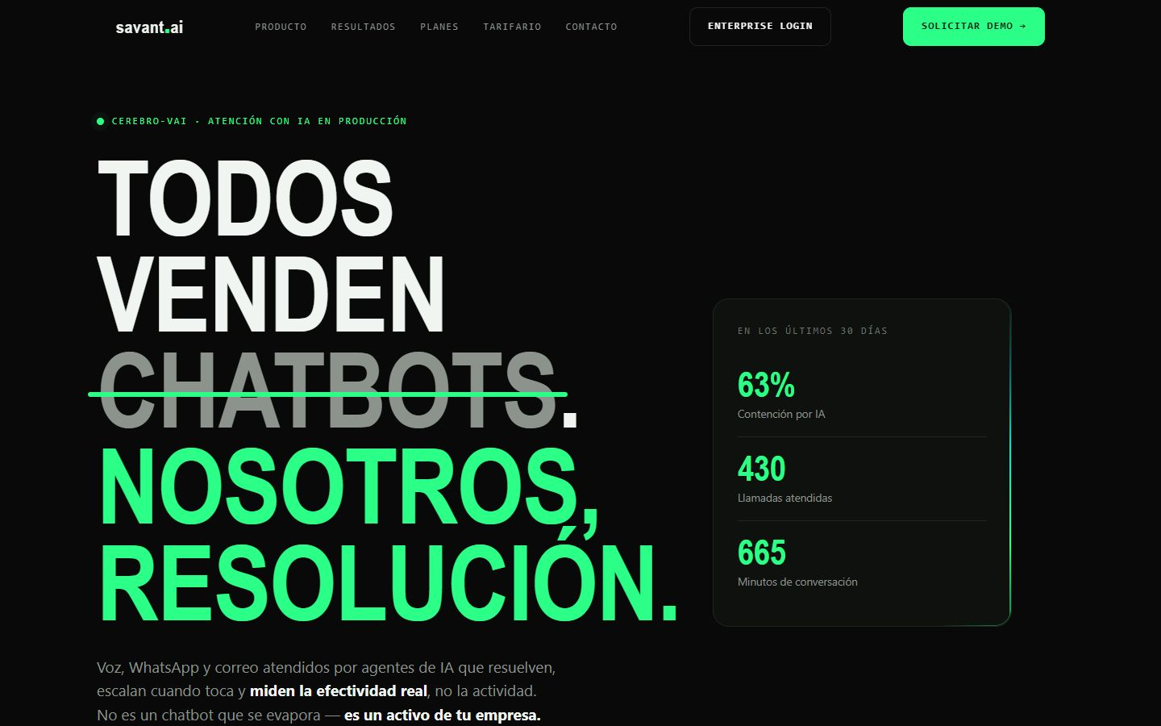
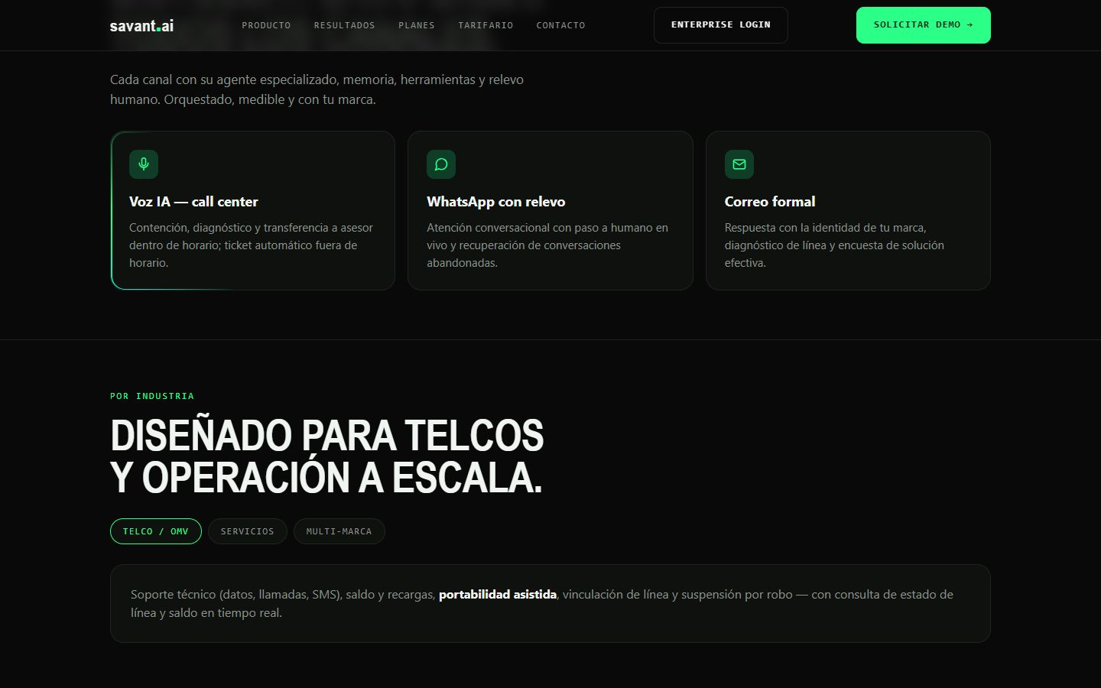
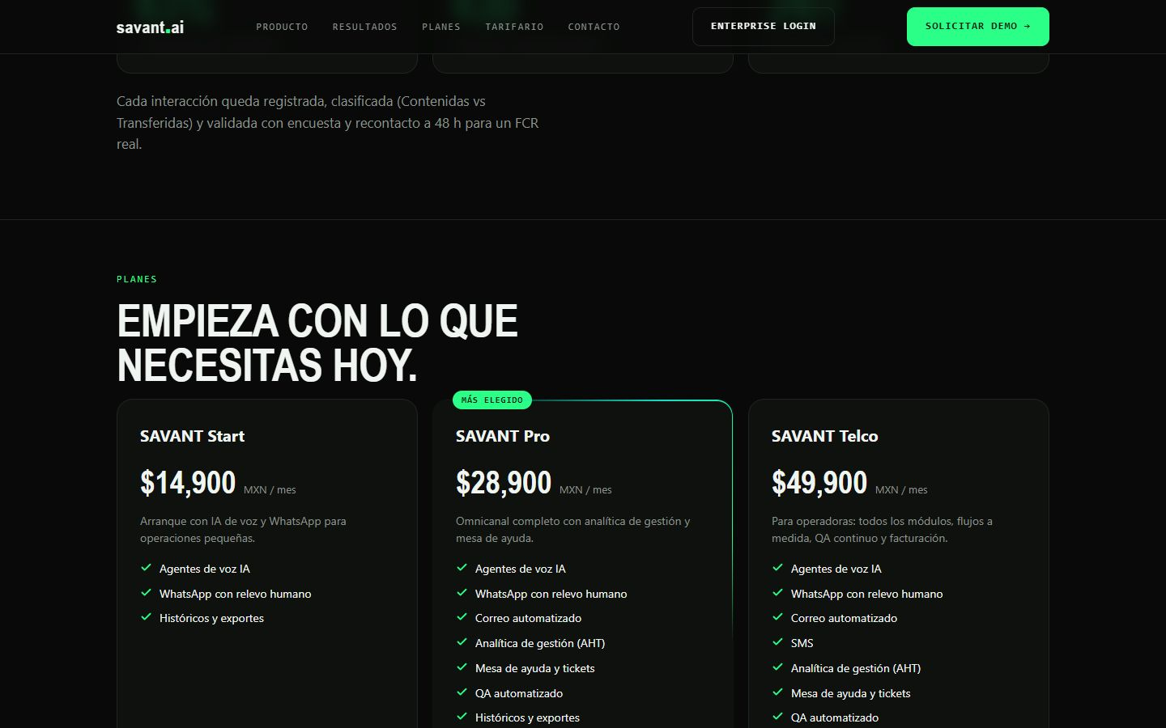
DASHBOARD-INXEL.MENTEIA.COM
The product, on screen

Slide 5
WHY WE WIN
Why SAVANT wins
Measurable resolution
Telecom domain
48 h FCR, not 'messages handled'.
Integrated with porting, balance and suspension.
Critical logic in code
Multi-brand in days
Deterministic guards: the LLM doesn't decide sensitive actions.
Flows, credentials and webhooks isolated per brand.

Slide 6
MARKET
Conversational AI: US$213 M today, US$2.5 B by 2034
TAM US$213.5M
TAM
Conversational AI in Mexico 2025 (IMARC); 2,495 M in 2034
SAM
SAM US$10M
21 M MVNO lines × US$0.50/year on AI customer service
SOM
SOM US$350k
12–15 carriers at US$24k/year

Slide 7
BUSINESS MODEL
Subscription per brand + pay per resolution
PLATFORM
USAGE
SETUP
US$800–1,500
US$0.15–0.30
US$3–8k
per brand per month: dashboard, channels and knowledge base.
per resolved conversation. Voice: from US$0.12 per minute.
integration with the carrier's system.

Slide 8
TRACTION
In production with 3 telecom brands
3
4
US$3.2k
63%
brands live (INXEL group)
channels: voice, WhatsApp, email, SMS
monthly revenue together with KYC
AI containment over 30 days
Last 30 days: 430 calls and 665 minutes handled by AI. Clients: inXel, Jamachulel and XAP.

Slide 9
COMPETITION
Telecom specialists, not another chatbot
Alternative | What it offers | Our advantage
Traditional call center (BPO) | Human agents billed by the hour | 24/7 at a fraction of the cost, no headcount growth
Generic chatbots (Botmaker, Yalo) | WhatsApp replies | Resolve inside the carrier's system
CX suites (Zendesk, Genesys) | Expensive generic platforms | Telecom-specialized, live in days
In-house build | Months and a dedicated team | Proven product with 3 brands live

Slide 10
GO-TO-MARKET
From 3 to 14 carriers in 24 months
01
02
03
Anchor case
MVNO enablers
LatAm
INXEL group as the reference for Mexico's ~30 MVNOs.
Bundled sales with MVNE/MVNA.
Colombia, Peru and Chile, where the MVNO model is growing.

Slide 11
WHAT THE ROUND ACHIEVES
24-month roadmap
MONTHS 1–6
MONTHS 7–12
MONTHS 13–18
MONTHS 19–24
Scalable product
Win the MVNOs
LatAm
New verticals
Migrate persistence to Postgres
Public FCR and containment metrics
2 new carriers
6 carriers in production
Partnership with an MVNO enabler
Reduce dependence on Twilio
First client outside Mexico
Sales module (abandonment recovery)
10 carriers
14 clients
First utility or fintech client
Break-even

Slide 12
FINANCIALS
24-month financial projection
US$23k
Monthly revenue at month 24
US$281k
Annualized revenue (ARR) at month 24
> 24 m
Monthly breakeven

Slide 13
THE OFFER
The round
US$825,000
USE OF FUNDS
Product and engineering team
42.7%
for 24.8% · 24 months of operation
Sales, marketing and customer success
23.5%
Founders (time dedicated to the project)
11.2%
PRE-MONEY
US$2,500,000
Contingency (10%)
9.1%
POST-MONEY
US$3,325,000
Infrastructure and AI compute
8.8%
INSTRUMENT
Post-money SAFE
Legal, compliance and tools
4.7%

Slide 14
TEAM
A team already running 9 AI products
RH
VD
FD
Rafael Herrera
Vladimir Díaz
Francisco D'Angelo
CEO / CFO
CTO
Head of Legal and Compliance
Strategy, finance and relationships with investors and corporate clients.
Architecture, AI and operation of Menteia's products in production.
Corporate structure, regulatory compliance and data protection.

Slide 15
Invest in SAVANT AI
We already resolve for 3 telecom brands. This round takes us to 14 and into LatAm.
Rafael Herrera · CEO / CFO
Vladimir Díaz · CTO
dashboard-inxel.menteia.com

