Slide 1
SEED ROUND · OCTOBER 2026
Menteia KYC
Identity verified against official sources in under 2 minutes.
kyc.menteia.com
by MENTEIA
Notes:
Menteia KYC: AI identity verification against INE and RENAPO in under 2 minutes, via link, no app, pay per use.

Slide 2
THE PROBLEM
Identifying customers in Mexico is slow, expensive and vulnerable
01
02
03
Regulatory obligation
Global providers
Rising fraud
Banks, fintechs and telcos must identify every customer.
Charge in dollars, with minimums, and don't understand the INE.
Photocopies, screens and stolen IDs.

Slide 3
THE SOLUTION
KYC against INE and RENAPO in under 2 minutes
01
02
03
04
05
Link
Live capture
Liveness check
Official sources
Decision
No app: the customer opens a link or uses the SDK.
INE or passport via camera; no gallery photos.
Head turns and face match against the ID.
Voter roll (INE) and CURP (RENAPO).
Approved or rejected via API and signed webhook.

Slide 4
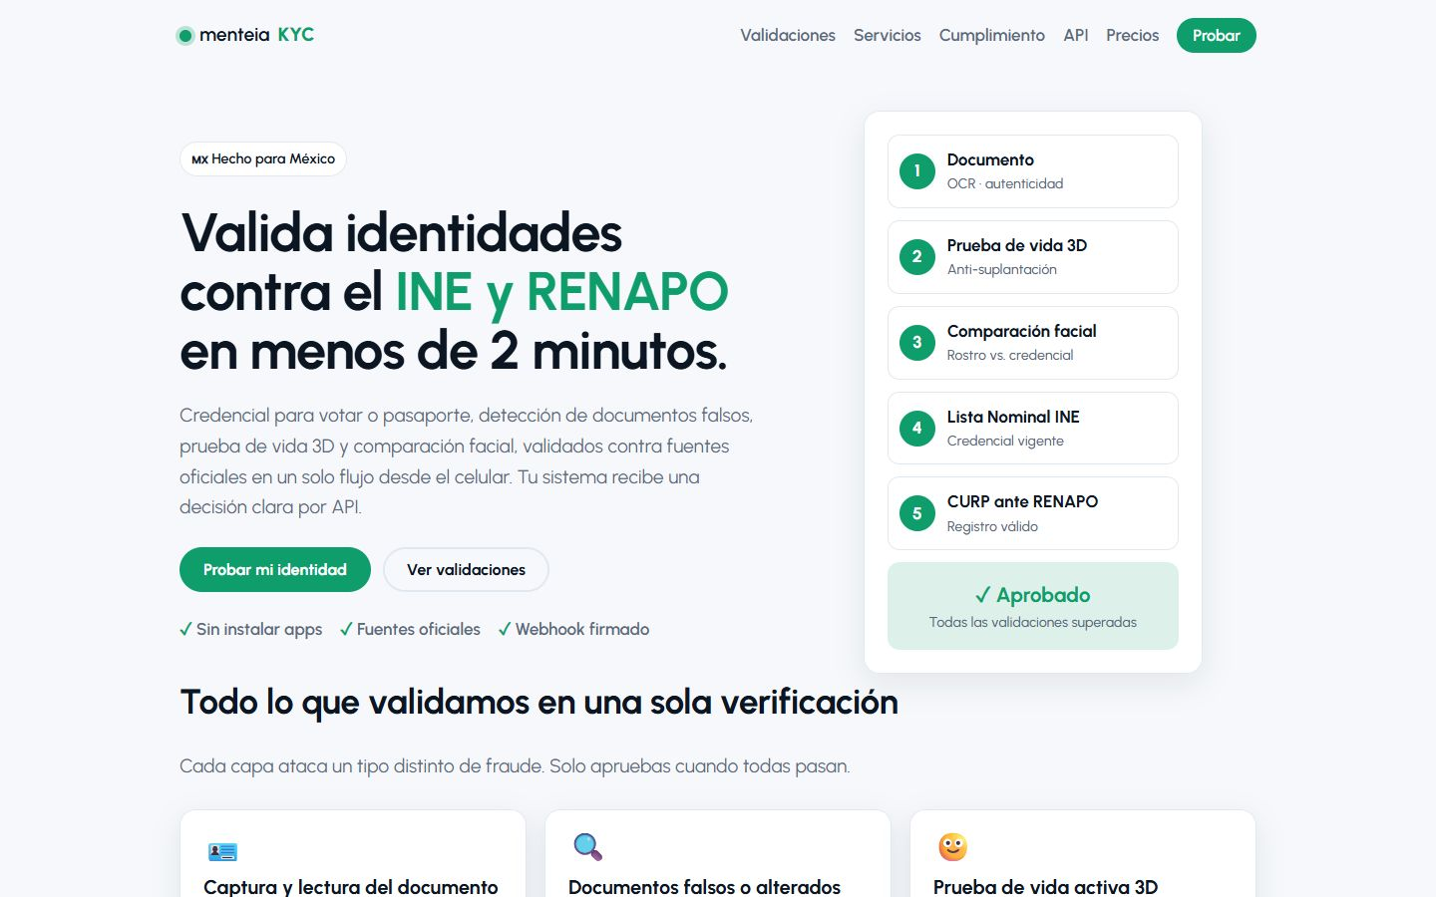
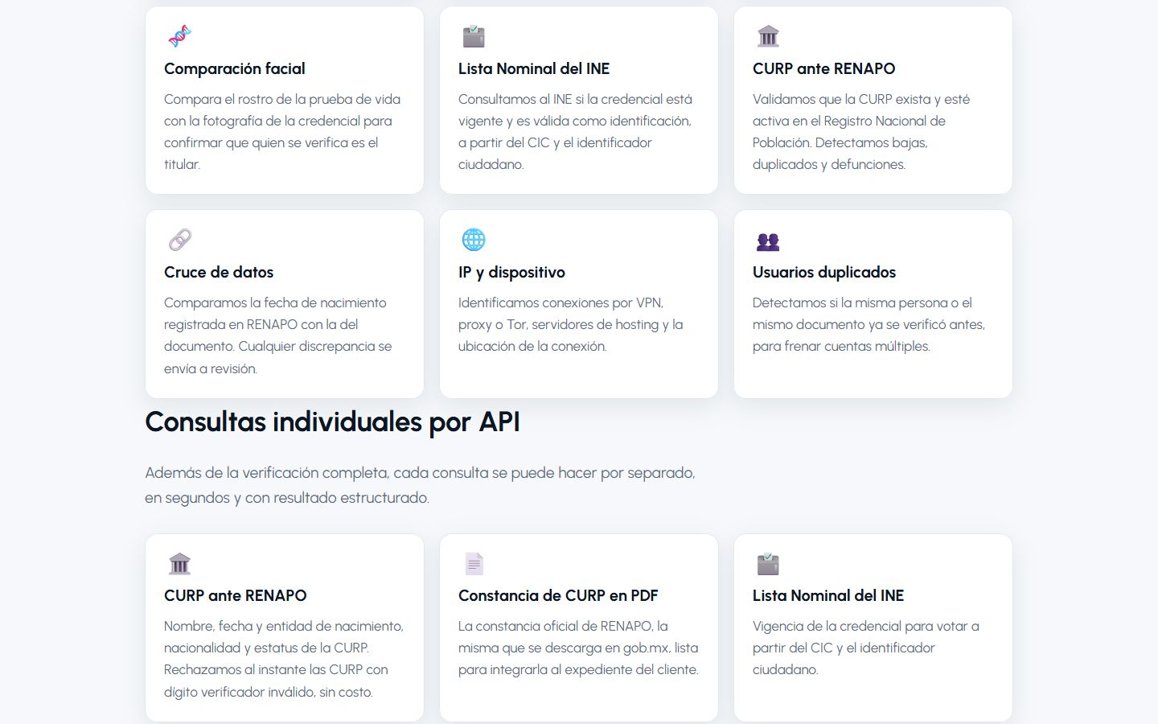
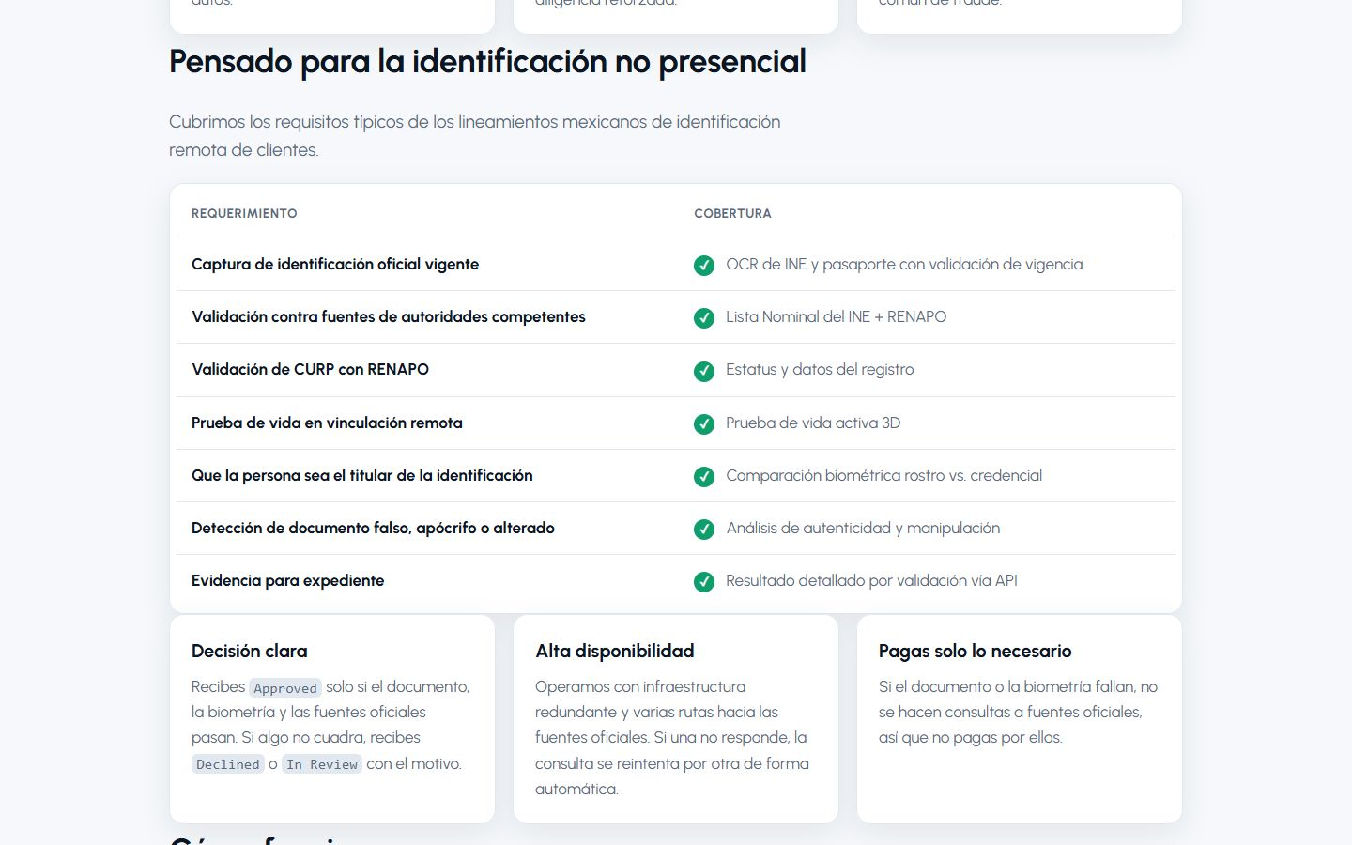
KYC.MENTEIA.COM
The product, on screen

Slide 5
WHY WE WIN
Built for Mexico, on proprietary technology
Built for the INE
Anti-fraud at capture
Front, back, QR vs MRZ, CURP, voter roll, REPUVE.
Detects photocopies, screens and objects over the ID.
In-house biometrics and OCR
White-label
Cost per verification far below global providers.
On the client's domain, with audit log replication.

Slide 6
MARKET
Identity verification: US$369 M in Mexico
TAM US$368.7M
TAM
Identity verification in Mexico 2025; US$728 M in 2030
SAM
SAM US$37M
Fintechs, SOFIPOs, MVNOs and mid-size companies via API
SOM
SOM US$500k
~250k verifications per year

Slide 7
BUSINESS MODEL
Pay per use, no fees or minimums
VERIFICATION
API LOOKUPS
WHITE-LABEL
US$0.40–1.20
US$0.10–0.25
US$500+
full check, by volume and tier (certified biometrics).
CURP, voter roll, REPUVE.
per month: own portal, SLA and log replication, plus usage.

Slide 8
TRACTION
In production from month one
~950
< 2 min
3
US$3.2k
verifications in the first weeks
per full verification
telecom brands in production
monthly revenue together with SAVANT
Client: INXEL group (inXel, Jamachulel, XAP). The engine also powers Vamo and Doble D.

Slide 9
COMPETITION
More local than the global players
Alternative | What it offers | Our advantage
Global (Incode, Mati/Metamap, Truora) | Multi-country KYC, priced in dollars | Built for INE/RENAPO, cheaper, no minimums
Verificamex / local validators | Standalone source lookups | Full flow with biometrics and anti-fraud
In-person onboarding | Branch and paper | 2 minutes from a phone
In-house build | Months and fraud risk | Ready via API, SDK or white-label

Slide 10
GO-TO-MARKET
From 1 to 30+ clients
01
02
03
Cross-selling
AML community
Integrators
Menteia products and SAVANT AI clients.
Compliance officers (AECGR) as a channel.
Core banking and loan origination.

Slide 11
WHAT THE ROUND ACHIEVES
24-month roadmap
MONTHS 1–6
MONTHS 7–12
MONTHS 13–18
MONTHS 19–24
Trust
Commercial scale
AML product
Platform
iBeta liveness certification
Privacy notice and contracts
5 new clients
15 active clients
Integration with 2 financial cores
Advanced e-signature
PEP and sanctions lists
Ongoing monitoring
First client outside Mexico
45k verifications per month
Break-even
Prepare Series A

Slide 12
FINANCIALS
24-month financial projection
US$27k
Monthly revenue at month 24
US$323k
Annualized revenue (ARR) at month 24
> 24 m
Monthly breakeven

Slide 13
THE OFFER
The round
US$725,000
USE OF FUNDS
Product and engineering team
46.4%
for 22.5% · 24 months of operation
Sales, marketing and customer success
19.8%
Founders (time dedicated to the project)
11.7%
PRE-MONEY
US$2,500,000
Contingency (10%)
9.1%
POST-MONEY
US$3,225,000
Legal, compliance and tools
7.5%
INSTRUMENT
Post-money SAFE
Infrastructure and AI compute
5.5%

Slide 14
TEAM
A team already running 9 AI products
RH
VD
FD
Rafael Herrera
Vladimir Díaz
Francisco D'Angelo
CEO / CFO
CTO
Head of Legal and Compliance
Strategy, finance and relationships with investors and corporate clients.
Architecture, AI and operation of Menteia's products in production.
Corporate structure, regulatory compliance and data protection.

Slide 15
Invest in Menteia KYC
Digital identity in Mexico needs a local provider. We're already in production.
Rafael Herrera · CEO / CFO
Vladimir Díaz · CTO
kyc.menteia.com

