Slide 1
SEED ROUND · OCTOBER 2026
Vamo
No customer ever waits at your dealership again.
cotizador.menteia.com
by MENTEIA
Notes:
Vamo: Kiosk + AI advisor on WhatsApp that greets, quotes, books test drives, verifies identity and builds the customer's loan application at the dealership.

Slide 2
THE PROBLEM
Every minute of waiting is a lost sale
01
02
03
Customers waiting
Slow financing
Blind funnel
The salesperson is busy and the customer goes to another dealership.
72% buy on credit; the loan file takes days.
Nobody knows which kiosk or model drove the sale.

Slide 3
THE SOLUTION
From QR to signed loan, no waiting
01
02
03
04
05
Scan
Chat
Drive
Finance
Close
Dynamic QR on a kiosk or totem.
AI advisor on WhatsApp and voice, 24/7.
Test drive booked with a reminder.
KYC, pre-filled bank application and signature.
CRM with funnel by dealership and kiosk.

Slide 4
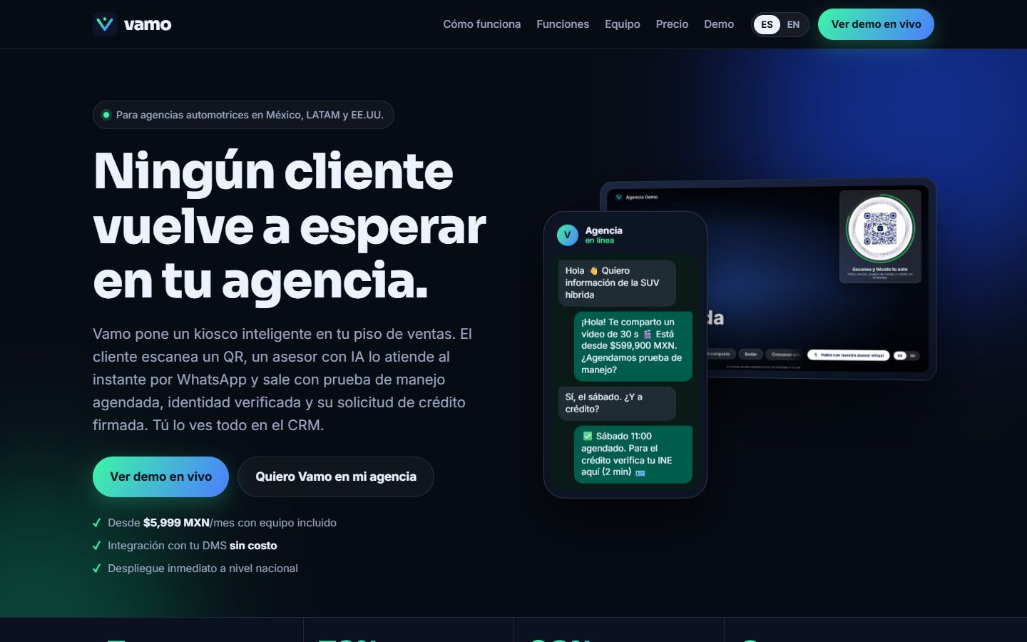
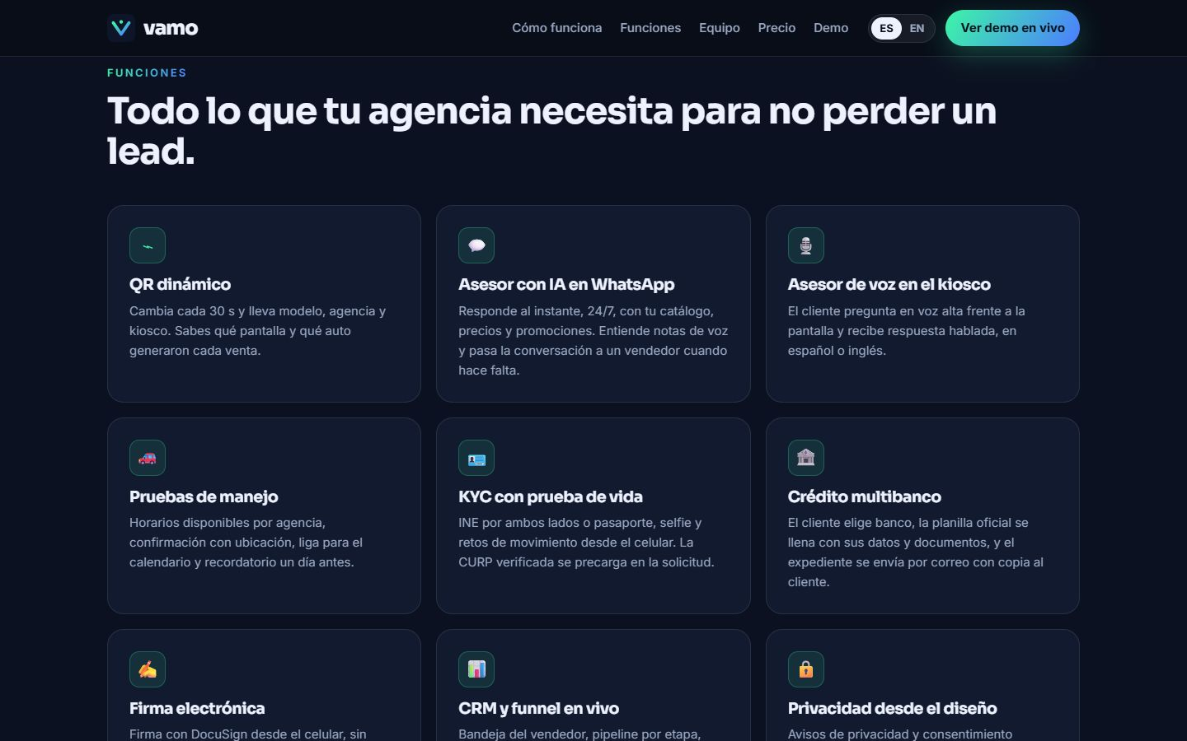
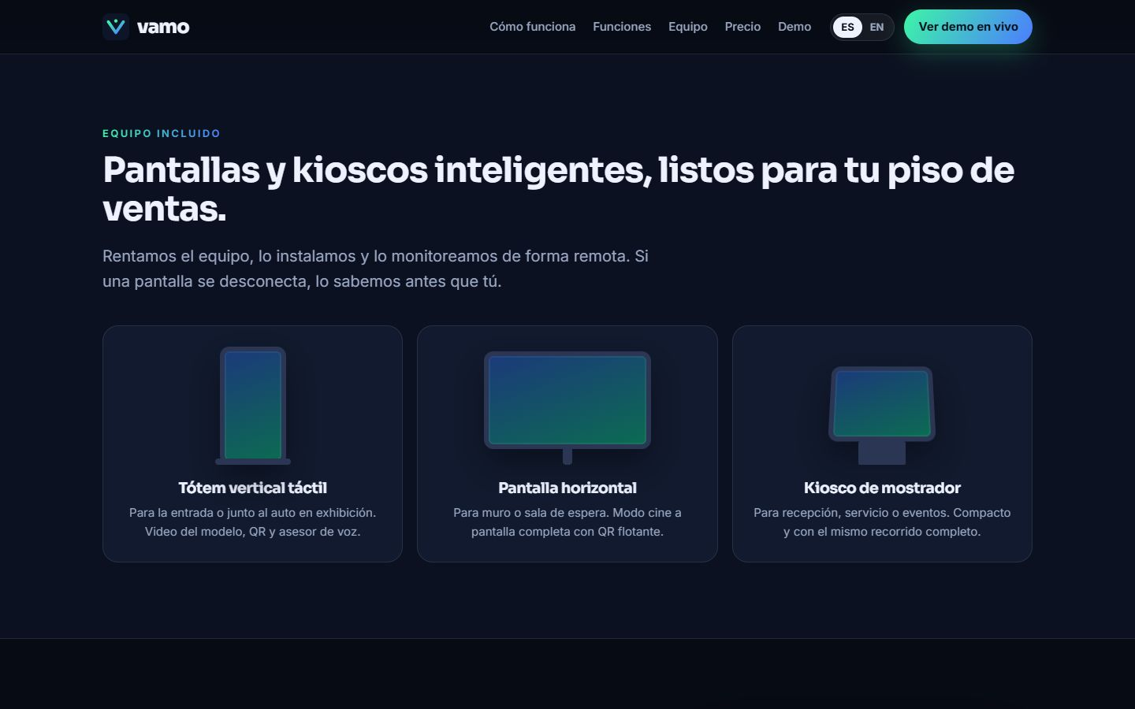
COTIZADOR.MENTEIA.COM
The product, on screen

Slide 5
WHY WE WIN
Serves like a salesperson, measures like a CRM
Full flow
Physical + digital
Greeting, test drive, identity, loan and signature in one.
Captures the customer on the floor; WhatsApp follows up.
Attribution
No upfront cost
Sale tied to dealership, kiosk and model.
Monthly lease with hardware, installation and support.

Slide 6
MARKET
2,800 dealerships and 1.5 M cars a year
TAM US$17M
TAM
2,800 dealerships in Mexico × US$6k/year
SAM
SAM US$4M
Ford, Lincoln and volume brands (~650 dealerships)
SOM
SOM US$350k
~60 kiosks in 24–36 months

Slide 7
BUSINESS MODEL
Lease per kiosk, all-inclusive
KIOSK
LOAN
WHATSAPP ONLY
US$324
US$15–30
US$189
per month: hardware, installation, AI advisor and support.
per completed loan file.
per month for digital dealerships.

Slide 8
TRACTION
Pilot with Ford and Lincoln
3
7
0 s
Ford / Lincoln locations in pilot
modules in production
wait for the customer
Full product: dynamic QR, WhatsApp, voice, test drives, KYC, multi-bank loans, signature and CRM.

Slide 9
COMPETITION
What no CRM or chatbot does alone
Alternative | What it offers | Our advantage
Automotive CRM (Salesforce, DealerSocket) | Lead management | Serves the customer on the floor and on WhatsApp
Brand chatbots | Generic answers | Quotes, books, verifies identity and builds the loan
Host / salesperson on duty | Limited human attention | 0 s wait, 24/7
Auto lending platforms | Financing only | From first contact to signed contract

Slide 10
GO-TO-MARKET
From 3 locations to 60 kiosks
01
02
03
Pilot → contract
Groups and brand
Lenders
Ford and Lincoln as the reference case.
Group-level sales and a program with the brand.
Banks that benefit from complete loan files.

Slide 11
WHAT THE ROUND ACHIEVES
24-month roadmap
MONTHS 1–6
MONTHS 7–12
MONTHS 13–18
MONTHS 19–24
Pilot to contract
Group and brand
Multi-brand
Scale
Ford/Lincoln pilot metrics
Convert 3 locations to contract
15 kiosks installed
Program with the brand
Integration with 2 banks
30 kiosks
Second and third brand
Used-car module
45 kiosks
~60 kiosks
First client outside Mexico
Break-even

Slide 12
FINANCIALS
24-month financial projection
US$26k
Monthly revenue at month 24
US$314k
Annualized revenue (ARR) at month 24
Month 23
Monthly breakeven

Slide 13
THE OFFER
The round
US$625,000
USE OF FUNDS
Product and engineering team
33.4%
for 25.8% · 24 months of operation
Sales, marketing and customer success
30.2%
Founders (time dedicated to the project)
11.4%
PRE-MONEY
US$1,800,000
Legal, compliance and tools
11.2%
POST-MONEY
US$2,425,000
Contingency (10%)
9.1%
INSTRUMENT
Post-money SAFE
Infrastructure and AI compute
4.8%

Slide 14
TEAM
A team already running 9 AI products
RH
VD
FD
Rafael Herrera
Vladimir Díaz
Francisco D'Angelo
CEO / CFO
CTO
Head of Legal and Compliance
Strategy, finance and relationships with investors and corporate clients.
Architecture, AI and operation of Menteia's products in production.
Corporate structure, regulatory compliance and data protection.

Slide 15
Invest in Vamo
Dealerships have already tried Vamo. This round rolls it out nationwide.
Rafael Herrera · CEO / CFO
Vladimir Díaz · CTO
cotizador.menteia.com

