Slide 1
SEED ROUND · OCTOBER 2026
Menteia Hedge
Invest with evidence. Decide with AI that explains itself.
hedge.menteia.com
by MENTEIA
Notes:
Menteia Hedge: AI investment committee: 12 analysts (quantitative and style-based) and a deterministic risk officer that recommend with evidence and explain every decision.

Slide 2
THE PROBLEM
Investing on gut feeling, without evidence
01
02
03
No committee
AI without proof
Advisers without technology
Investors decide alone or on social media tips.
Return promises backed by biased backtests.
154 CNBV advisers analyze by hand.

Slide 3
THE SOLUTION
An AI investment committee that explains itself
01
02
03
04
12 analysts
Rule-based risk
Committee
Validation
5 quantitative + 7 style agents.
VaR, liquidity and deterministic vetoes.
Sizes the position; the LLM doesn't touch the order.
Point-in-time backtests with an honest verdict.

Slide 4
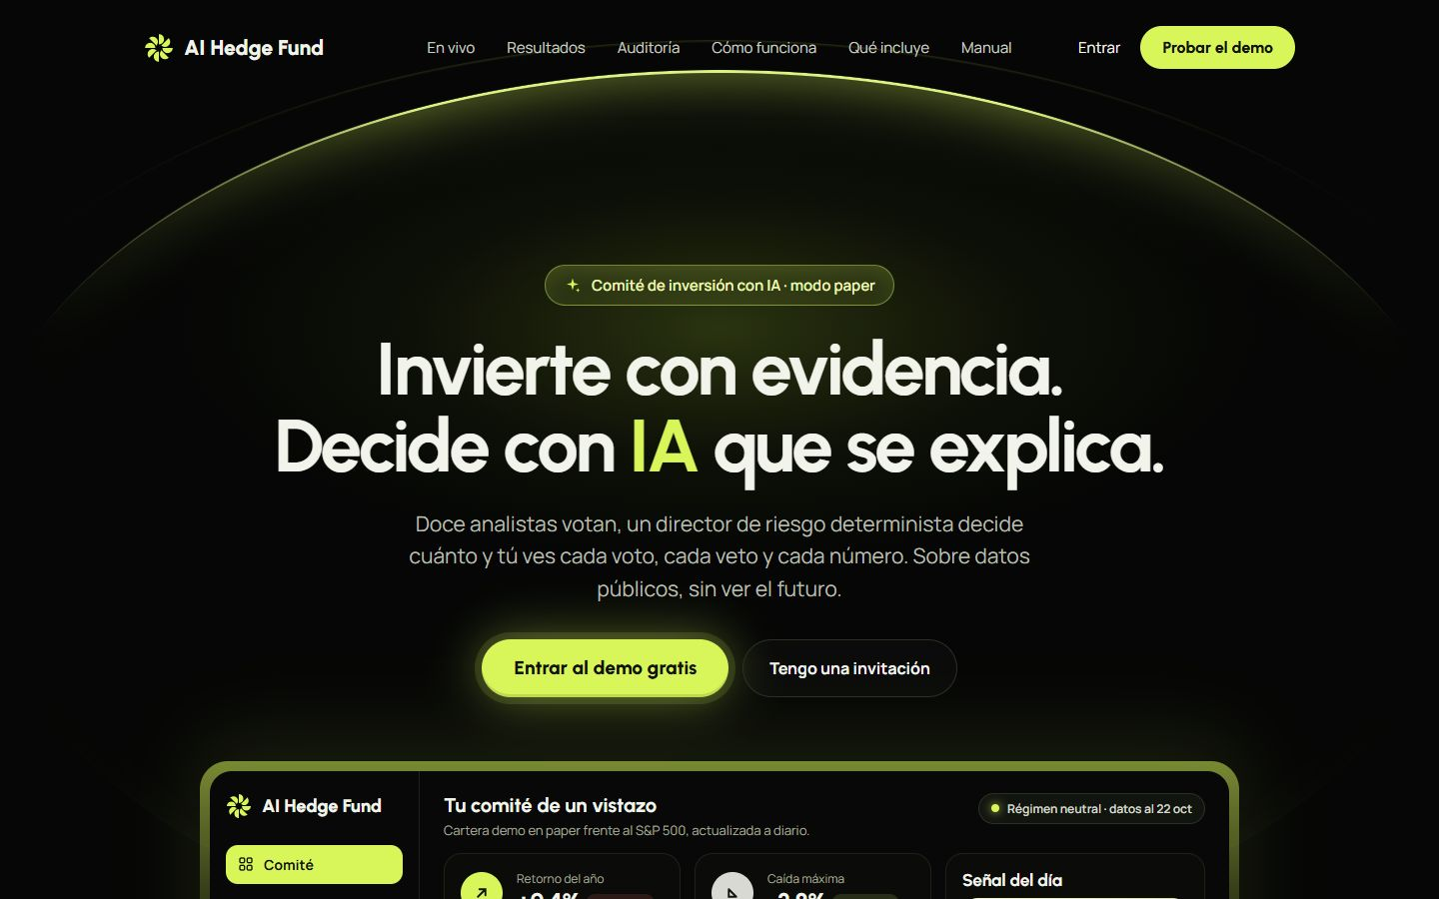
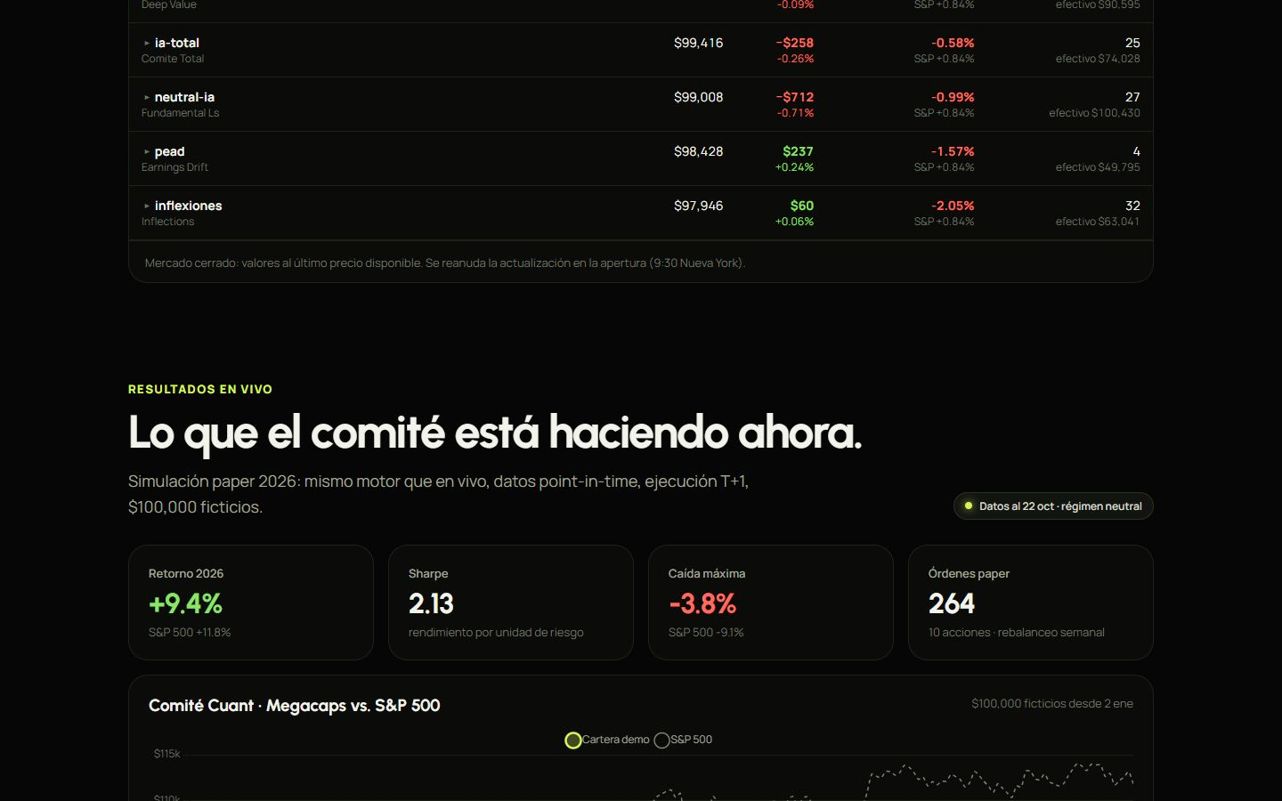
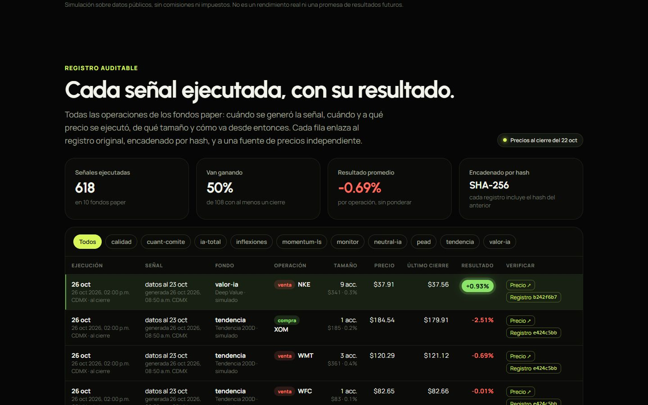
HEDGE.MENTEIA.COM
The product, on screen

Slide 5
WHY WE WIN
Evidence, not promises
Explainable AI
Auditable risk
Who said what and why, in every recommendation.
Deterministic rules, not the LLM.
Statistical honesty
Hash-chained record
Point-in-time data; admits 'NO EDGE'.
Results that can't be dressed up.

Slide 6
MARKET
Automated advice for 3 M investors
TAM US$60M
TAM
3 M investors × US$4k × 0.5% per year
SAM
SAM US$6M
Self-directed investors + independent advisers
SOM
SOM US$200k
~800 subscribers and 15 advisers

Slide 7
BUSINESS MODEL
Freemium + white-label for advisers
PRO
ADVISER
DEMO
US$15
US$300
Free
per month: full committee, signals and portfolios.
per month: white-label for CNBV advisers.
quantitative analysis of up to 10 tickers.

Slide 8
TRACTION
MVP in production
12
34
1
AI analysts on the committee
automated test files
multi-user web MVP live
Idea stage, technically validated. Next step: CNBV registration and first subscribers.

Slide 9
COMPETITION
Between the terminal and the robo-advisor
Alternative | What it offers | Our advantage
Robo-advisors (Fiduz, Finamex) | Passive portfolios | Active, explainable per-stock analysis
Terminals (Bloomberg, Koyfin) | Data without decisions | Committee that recommends and sizes
Social media gurus and signals | Opinions without evidence | Honest backtests and auditable record
Generic ChatGPT | Answers without verified data | Point-in-time data and deterministic risk

Slide 10
GO-TO-MARKET
Validate, register, scale
01
02
03
Audited content
Demo → Pro
CNBV advisers
Public results as marketing.
Freemium funnel.
B2B white-label license.

Slide 11
WHAT THE ROUND ACHIEVES
24-month roadmap
MONTHS 1–6
MONTHS 7–12
MONTHS 13–18
MONTHS 19–24
Validate and register
Commercial launch
Mexican equities
Scale
Own repository and differentiation from upstream
CNBV adviser registration
Market interviews
Pro subscription
First 3 white-label advisers
200 subscribers
BMV/BIVA coverage
Brokerage partnership
450 subscribers
~700 subscribers
15 advisers
Decide on Series A or integration with Doble D

Slide 12
FINANCIALS
24-month financial projection
US$15k
Monthly revenue at month 24
US$184k
Annualized revenue (ARR) at month 24
> 24 m
Monthly breakeven

Slide 13
THE OFFER
The round
US$450,000
USE OF FUNDS
Product and engineering team
59.7%
for 31% · 24 months of operation
Sales, marketing and customer success
11.6%
Contingency (10%)
9.1%
PRE-MONEY
US$1,000,000
Founders (time dedicated to the project)
7.2%
POST-MONEY
US$1,450,000
Legal, compliance and tools
6.5%
INSTRUMENT
SAFE
Infrastructure and AI compute
5.9%

Slide 14
TEAM
A team already running 9 AI products
RH
VD
FD
Rafael Herrera
Vladimir Díaz
Francisco D'Angelo
CEO / CFO
CTO
Head of Legal and Compliance
Strategy, finance and relationships with investors and corporate clients.
Architecture, AI and operation of Menteia's products in production.
Corporate structure, regulatory compliance and data protection.

Slide 15
Invest in Menteia Hedge
Honest, explainable investment AI. We're looking for partners to take it to market.
Rafael Herrera · CEO / CFO
Vladimir Díaz · CTO
hedge.menteia.com

