Slide 1
SEED ROUND · OCTOBER 2026
Seguro Sin Vueltas
Use your health insurance without the runaround.
misegurosinvueltas.com
by MENTEIA
Notes:
Seguro Sin Vueltas: AI assistant on WhatsApp that guides patients with major medical insurance at no cost and routes them to in-network doctors and hospitals, backed by VITAE Asesores.

Slide 2
THE PROBLEM
Having insurance is not knowing how to use it
01
02
03
14.5 M insured
Lost patients
Doctors without patients
Networks, deductibles, co-insurance, reimbursements: a maze.
They go to the wrong hospital or pay out of pocket.
Nobody connects insured people with the right network.

Slide 3
THE SOLUTION
An advisor on your side, on WhatsApp
01
02
03
04
Write
AI captures
Human advisor
Routing
WhatsApp from the website or a QR code.
Details, policy (OCR) and voice notes.
Case assigned to the available specialist.
Doctor and hospital in your policy's network.

Slide 4


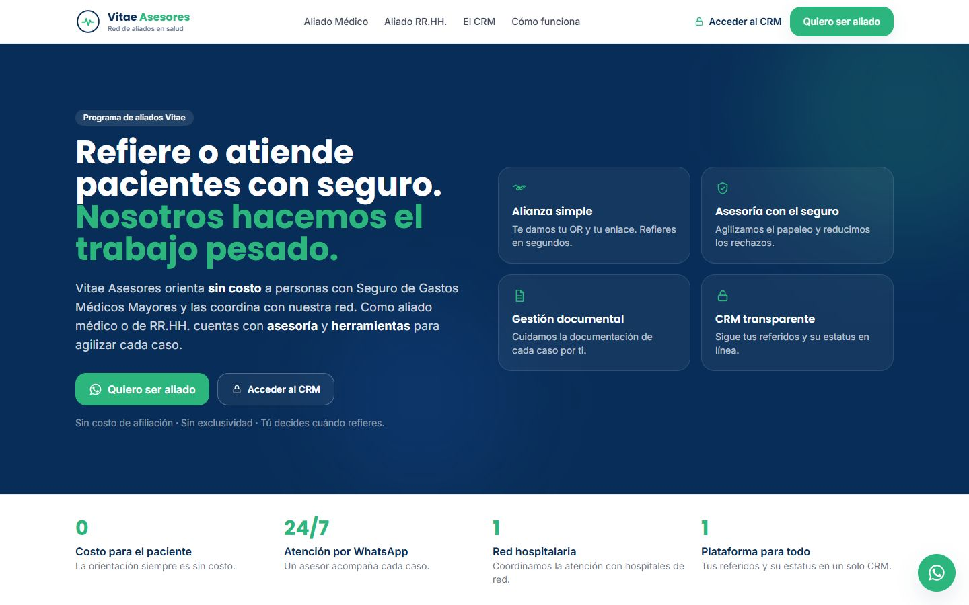
MISEGUROSINVUELTAS.COM
The product, on screen

Slide 5
WHY WE WIN
AI for the heavy lifting, humans for the sensitive part
Human in the loop
Health guardrails
AI prepares; the expert advisor decides.
No coverage promises or medical advice.
Free for the patient
Our own CRM
Partners and companies pay.
Prioritized queue, case files and role-based security.

Slide 6
MARKET
US$8.5 B in health insurance premiums
TAM US$29M
TAM
~725k major medical hospital events per year × US$40
SAM
SAM US$11.6M
Mexico City and State of Mexico (~40%)
SOM
SOM US$300k
~750 cases per month + partner doctors

Slide 7
BUSINESS MODEL
Free for the patient; partners and companies pay
PER-CASE FEE
PARTNER
COMPANIES
US$25–60
US$50
US$1–2
coordination fee per patient attended by a partner.
per month: profile, scheduling and tools.
per employee per month, through HR.

Slide 8
TRACTION
Full platform in production
Jul-26
5
24/7
WhatsApp agent in production
components: websites, agent, CRM, analytics
free guidance
Operated by VITAE Asesores. Next step: sign partners and document real cases.

Slide 9
COMPETITION
The only advisor on the patient's side
Alternative | What it offers | Our advantage
Traditional insurance agent | Sells the policy, offers little follow-up | 24/7 support when using it
Insurer's call center | Paperwork, not guidance | Advisor on the patient's side
Doctor directories (Doctoralia) | Search and book | Connects based on your policy's network
Reimbursement handlers | After-the-fact paperwork | Guidance before, during and after

Slide 10
GO-TO-MARKET
Patients, partners and companies
01
02
03
Patients
Partners
Companies
SEO, content and QR referrers.
Doctors and hospitals with no upfront fee.
HR as a wellness channel.

Slide 11
WHAT THE ROUND ACHIEVES
24-month roadmap
MONTHS 1–6
MONTHS 7–12
MONTHS 13–18
MONTHS 19–24
Compliance and network
Monetization
Companies
Expansion
Health data privacy notices
30 partner doctors signed
100 cases/month
Per-case fee with partners
Doctor portal
250 cases/month
HR program with 3 companies
Voice agent
400 cases/month
Guadalajara and Monterrey
~750 cases/month
Break-even

Slide 12
FINANCIALS
24-month financial projection
US$32k
Monthly revenue at month 24
US$382k
Annualized revenue (ARR) at month 24
Month 21
Monthly breakeven

Slide 13
THE OFFER
The round
US$500,000
USE OF FUNDS
Sales, marketing and customer success
55%
for 25% · 24 months of operation
Product and engineering team
17.6%
Founders (time dedicated to the project)
9.1%
PRE-MONEY
US$1,500,000
Contingency (10%)
9.1%
POST-MONEY
US$2,000,000
Legal, compliance and tools
5.3%
INSTRUMENT
Post-money SAFE
Infrastructure and AI compute
3.9%

Slide 14
TEAM
A team already running 9 AI products
RH
VD
FD
Rafael Herrera
Vladimir Díaz
Francisco D'Angelo
CEO / CFO
CTO
Head of Legal and Compliance
Strategy, finance and relationships with investors and corporate clients.
Architecture, AI and operation of Menteia's products in production.
Corporate structure, regulatory compliance and data protection.

Slide 15
Invest in Seguro Sin Vueltas
Millions of insured people don't know how to use their insurance. We guide them.
Rafael Herrera · CEO / CFO
Vladimir Díaz · CTO
misegurosinvueltas.com

