Slide 1
SEED ROUND · OCTOBER 2026
Sommelier IA
The sommelier that never rests.
sergiocamacho.pro
by MENTEIA
Notes:
Sommelier IA: AI voice sommelier and WhatsApp concierge that recommends pairings, quotes, books and follows up with every customer of restaurants, chefs, wineries and wine shops.

Slide 2
THE PROBLEM
Nobody answers, nobody recommends, nobody remembers
01
02
03
Unanswered WhatsApp
Scarce sommeliers
Forgotten customers
Bookings and events lost after hours.
Most can't offer expert recommendations.
Preferences in scattered chats, no repeat purchases.

Slide 3
THE SOLUTION
An AI sommelier and concierge, 24/7
01
02
03
04
Voice sommelier
WhatsApp concierge
CRM
Repeat purchases
Pairs any dish through conversation.
Quotes, books and curates experiences.
Each customer's preferences and occasions.
Automatic follow-up and campaigns.

Slide 4
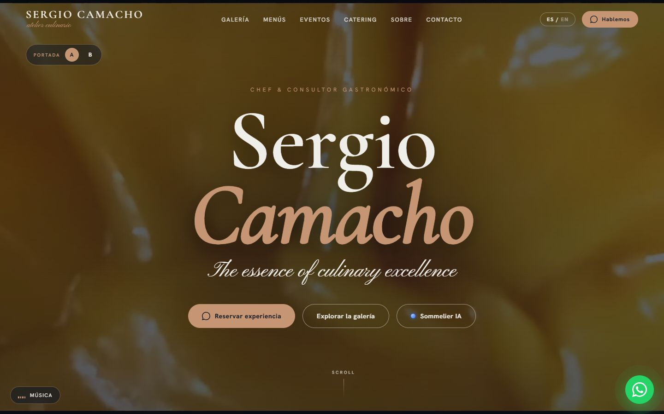
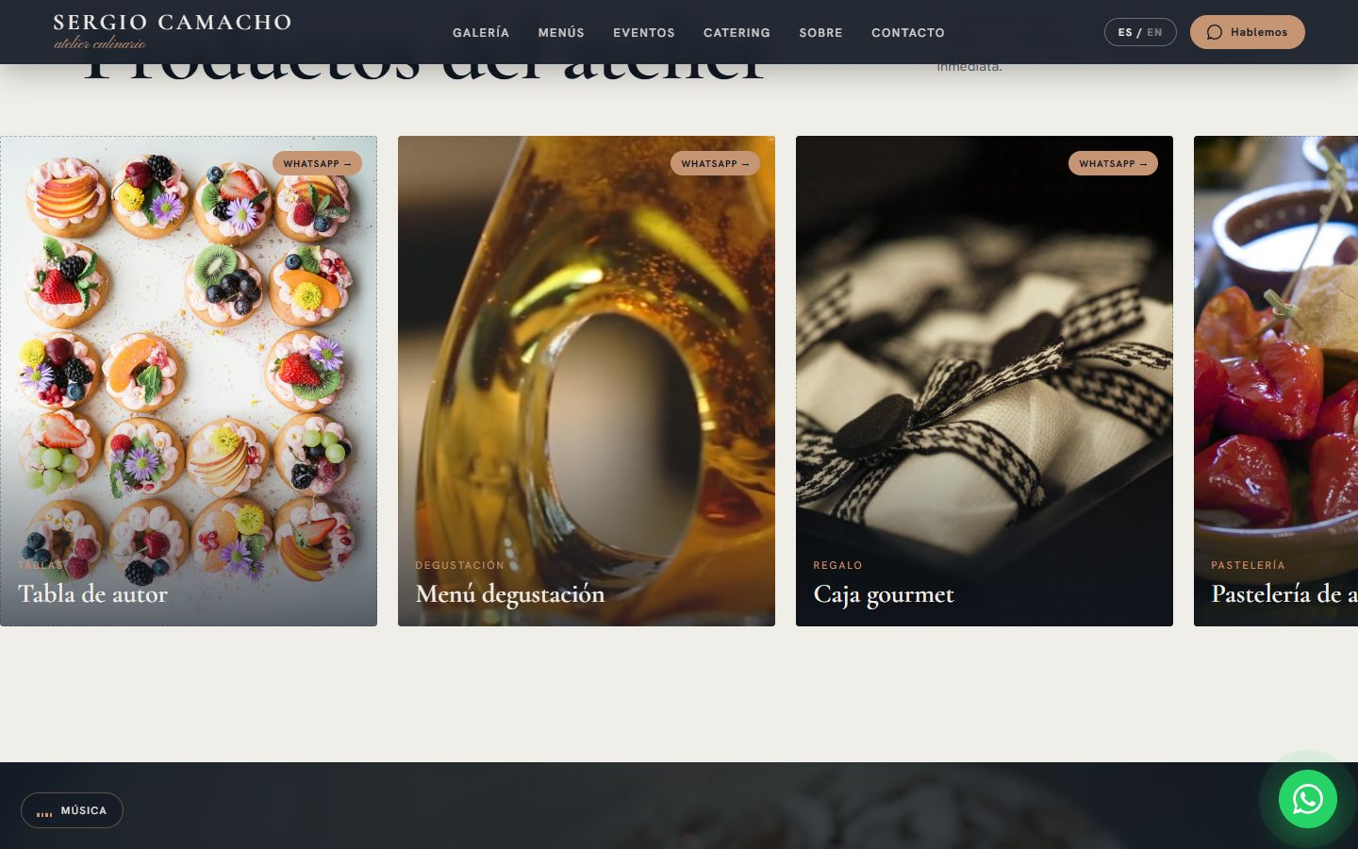
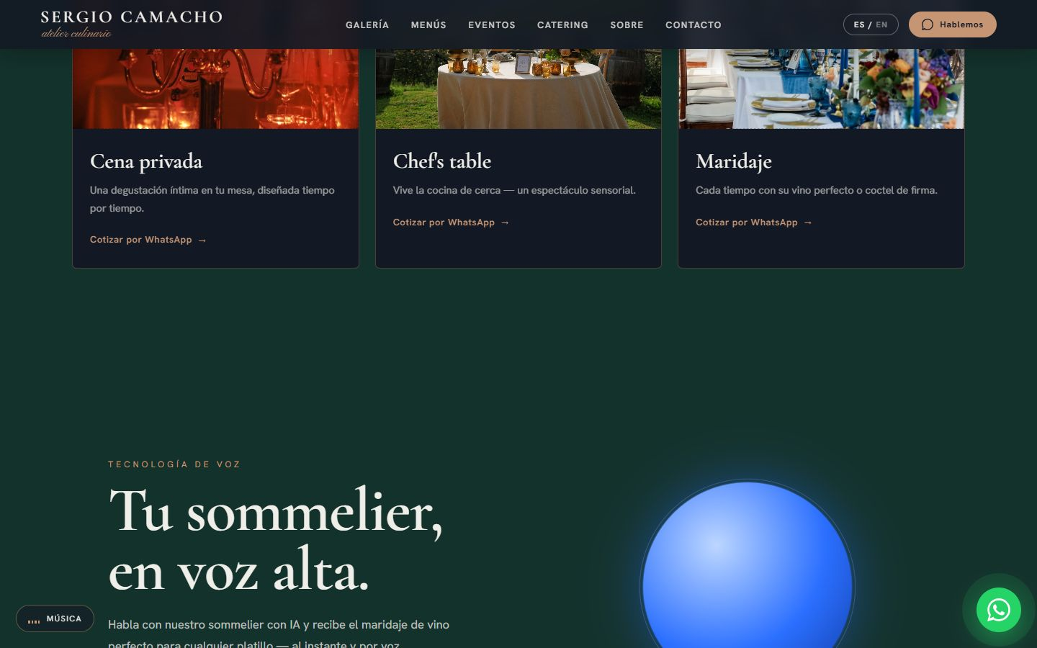
SERGIOCAMACHO.PRO
The product, on screen

Slide 5
WHY WE WIN
Luxury experience, wine knowledge
Premium voice
Pairing expert
Brand-curated tone, not a chatbot.
Wine is the product, not an extra.
Zero forms
Template in days
The conversation converts.
Website + agents + CRM per business.

Slide 6
MARKET
515k food and beverage businesses
TAM US$7.5M
TAM
25k businesses with a wine list × US$300/year
SAM
SAM US$1.2M
3k high-end businesses × US$400/year
SOM
SOM US$130k
~45 businesses with a US$3k/year ticket

Slide 7
BUSINESS MODEL
Setup + subscription + wine
SOMMELIER
CONCIERGE
WINE
US$300
US$150
3–5%
per month: voice, WhatsApp and CRM.
per month: WhatsApp agent.
commission on attributed sales.

Slide 8
TRACTION
Showcase case in production
1
2
+200
showcase customer: Chef Sergio Camacho
agents: voice sommelier and concierge
events by the showcase customer
sergiocamacho.pro: premium website with live voice sommelier and WhatsApp concierge.

Slide 9
COMPETITION
More than bookings, more than a chatbot
Alternative | What it offers | Our advantage
Booking platforms (OpenTable) | Table reservations | Recommends, quotes events and sells wine
Generic WhatsApp chatbots | Menu-based answers | Natural voice and pairing knowledge
Human sommelier | Premium experience, high cost | Available 24/7 at a fraction of the cost
Restaurant CRM (Fudo, Toteat) | Point of sale and operations | Conversational relationship and repeat purchases

Slide 10
GO-TO-MARKET
From showcase case to 45 businesses
01
02
03
Showcase case
Direct
Distributors
Chef Sergio Camacho as a live demo.
Chefs, restaurants and wineries.
Wine partnerships and harvest festivals.

Slide 11
WHAT THE ROUND ACHIEVES
24-month roadmap
MONTHS 1–6
MONTHS 7–12
MONTHS 13–18
MONTHS 19–24
Template
Wine
Wine tourism
Scale
Multi-customer product
Showcase case metrics
8 businesses
Wine catalog and sales on WhatsApp
Partnership with a distributor
18 businesses
Valle de Guadalupe wineries
Repeat-purchase campaigns
30 businesses
~45 businesses
English version for tourist destinations
Evaluate integration into the Menteia platform

Slide 12
FINANCIALS
24-month financial projection
US$12k
Monthly revenue at month 24
US$141k
Annualized revenue (ARR) at month 24
Month 23
Monthly breakeven

Slide 13
THE OFFER
The round
US$275,000
USE OF FUNDS
Sales, marketing and customer success
37.4%
for 25.6% · 24 months of operation
Product and engineering team
32.7%
Founders (time dedicated to the project)
10.2%
PRE-MONEY
US$800,000
Contingency (10%)
9.1%
POST-MONEY
US$1,075,000
Legal, compliance and tools
5.8%
INSTRUMENT
SAFE
Infrastructure and AI compute
4.8%

Slide 14
TEAM
A team already running 9 AI products
RH
VD
FD
Rafael Herrera
Vladimir Díaz
Francisco D'Angelo
CEO / CFO
CTO
Head of Legal and Compliance
Strategy, finance and relationships with investors and corporate clients.
Architecture, AI and operation of Menteia's products in production.
Corporate structure, regulatory compliance and data protection.

Slide 15
Invest in Sommelier IA
Luxury hospitality deserves AI with good taste.
Rafael Herrera · CEO / CFO
Vladimir Díaz · CTO
menteia.com

