Slide 1
SEED ROUND · OCTOBER 2026
Copiloto Aero
Quote in hours what takes days today, without losing control.
copiloto.indumet.org
by MENTEIA
Notes:
Copiloto Aero: AI quoting cockpit for aerospace suppliers: reads requests and drawings, prepares the quote with the company's pricing engine, and the analyst approves every section.

Slide 2
THE PROBLEM
Quoting an aerospace part takes days
01
02
03
Complex RFQs
Trapped knowledge
Costly errors
Drawings, materials and tolerances: days of an expert analyst's time.
In a few heads and thousands of quotes nobody looks up.
A wrong part number costs the order.

Slide 3
THE SOLUTION
An AI quoting cockpit, with the engineer in command
01
02
03
04
05
Email → session
Drawing triage
History
Approval
Sending
Each RFQ linked to the CRM and pricing engine.
Computer vision detects discrepancies.
Past quotes as context.
The analyst approves section by section.
PDF and email ready; nothing goes out without a human.

Slide 4
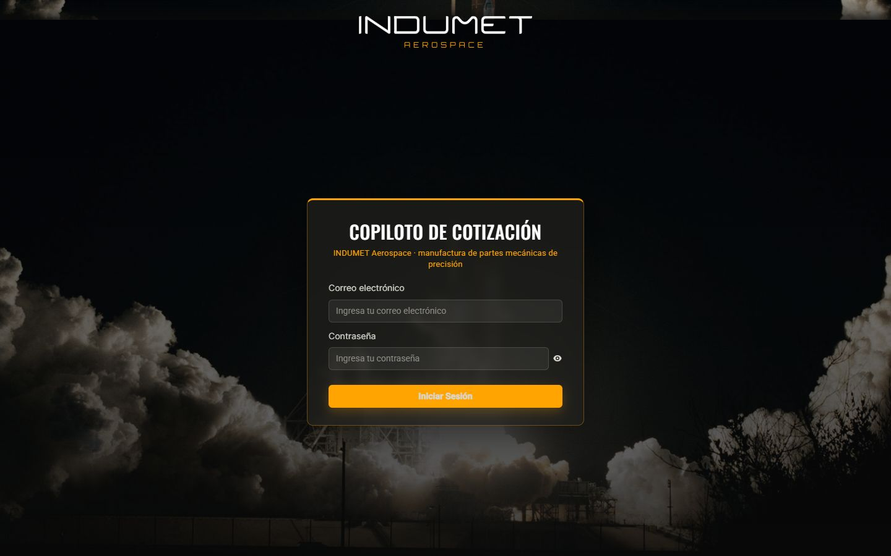
COPILOTO.INDUMET.ORG
The product, on screen
AI quoting cockpit for aerospace suppliers: reads requests and drawings, prepares the quote with the company's pricing engine, and the analyst approves every section.

Slide 5
WHY WE WIN
Reliable AI for a regulated industry
Zero LLM numbers
Human at every gate
Every figure comes from the pricing engine.
Technical, pricing and sending.
Learns from your history
On top of what you use
Past quotes as a knowledge base.
Existing email, CRM and engine.

Slide 6
MARKET
US$13.6 B in aerospace exports
TAM US$45M
TAM
~3k suppliers that quote against drawings × US$15k/year
SAM
SAM US$5.8M
386 aerospace companies in Mexico × US$15k/year
SOM
SOM US$250k
~11 companies with a US$22k/year ticket

Slide 7
BUSINESS MODEL
Implementation + subscription per company
SUBSCRIPTION
IMPLEMENTATION
EXTRA USER
US$1,500
US$8–15k
US$100
per month per company (up to 10 users).
integration and historical data ingestion.
per user per month.

Slide 8
TRACTION
In production in the aerospace sector
929
4,600
7
26
past quotes ingested
line items in the knowledge base
INDUMET users operating it
agent tools
Anchor customer: INDUMET. Real inbox, live CRM and quote PDFs in production.

Slide 9
COMPETITION
Not Excel, not a rigid ERP, not a chat that makes things up
Alternative | What it offers | Our advantage
Manual quoting (Excel + email) | What they do today | Days → hours, with history and traceability
Industrial ERP / CPQ (SAP, Paperless Parts) | Expensive, rigid configurators | Sits on top of the existing CRM and email
Generic AI chat | Answers, but makes up numbers | Zero LLM numbers; human at every gate
Custom consulting | Long projects | Ready product in weeks

Slide 10
GO-TO-MARKET
From 1 to 11 aerospace suppliers
01
02
03
INDUMET case
Clusters
Nearshoring
Reference in production.
Querétaro, Chihuahua, Sonora, BC through FEMIA.
US suppliers through Mexican customers.

Slide 11
WHAT THE ROUND ACHIEVES
24-month roadmap
MONTHS 1–6
MONTHS 7–12
MONTHS 13–18
MONTHS 19–24
Multi-customer product
Clusters
Our own pricing engine
Precision manufacturing
Contract with INDUMET and savings metrics
Generic pricing engine connector
2 new customers
Presence in Querétaro and Chihuahua
Integration with 2 ERPs
5 customers
Costing module for companies without one
First US customer
8 customers
~11 customers
Medical vertical
Break-even

Slide 12
FINANCIALS
24-month financial projection
US$29k
Monthly revenue at month 24
US$344k
Annualized revenue (ARR) at month 24
Month 18
Monthly breakeven

Slide 13
THE OFFER
The round
US$575,000
USE OF FUNDS
Product and engineering team
46.8%
for 24.2% · 24 months of operation
Sales, marketing and customer success
22.5%
Founders (time dedicated to the project)
9.5%
PRE-MONEY
US$1,800,000
Contingency (10%)
9.1%
POST-MONEY
US$2,375,000
Legal, compliance and tools
6.5%
INSTRUMENT
Post-money SAFE
Infrastructure and AI compute
5.6%

Slide 14
TEAM
A team already running 9 AI products
RH
VD
FD
Rafael Herrera
Vladimir Díaz
Francisco D'Angelo
CEO / CFO
CTO
Head of Legal and Compliance
Strategy, finance and relationships with investors and corporate clients.
Architecture, AI and operation of Menteia's products in production.
Corporate structure, regulatory compliance and data protection.

Slide 15
Invest in Copiloto Aero
Mexico's aerospace industry breaks export records every year. Its quoting should speed up too.
Rafael Herrera · CEO / CFO
Vladimir Díaz · CTO
copiloto.indumet.org

