Slide 1
SEED ROUND · OCTOBER 2026
PlaneTech Air Express
The part your aircraft needs, quoted in hours, not days.
planetechair.me
by MENTEIA
Notes:
PlaneTech Air Express: Express sale of aircraft parts from Miami for operators and repair shops in Mexico: an AI agent searches the global market for the part, requests quotes from suppliers and delivers the proposal to the customer in hours.

Slide 2
THE PROBLEM
An aircraft on the ground costs thousands per day
01
02
03
Costly AOG
Few suppliers
Quoting is slow
Every day without the part is an aircraft that doesn't fly.
Limited local inventory and customs delays.
Hundreds of offers to review by hand for each part.

Slide 3
THE SOLUTION
A Miami broker run by AI
01
02
03
04
05
Request by chat
Global sourcing
Automatic RFQ
Proposal
Delivery
Part number, data plate photo or voice note.
Hundreds of offers reviewed in minutes.
Every relevant supplier, in one pass.
PDF with price, condition and certificates.
Miami → Toluca in 2–4 days; AOG in 24–48 h.

Slide 4
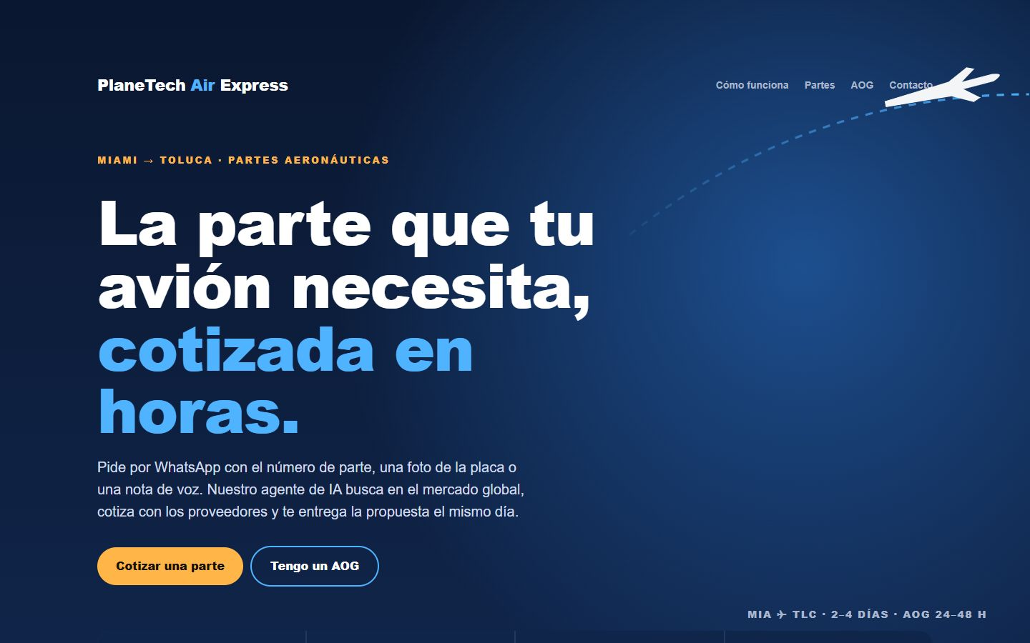
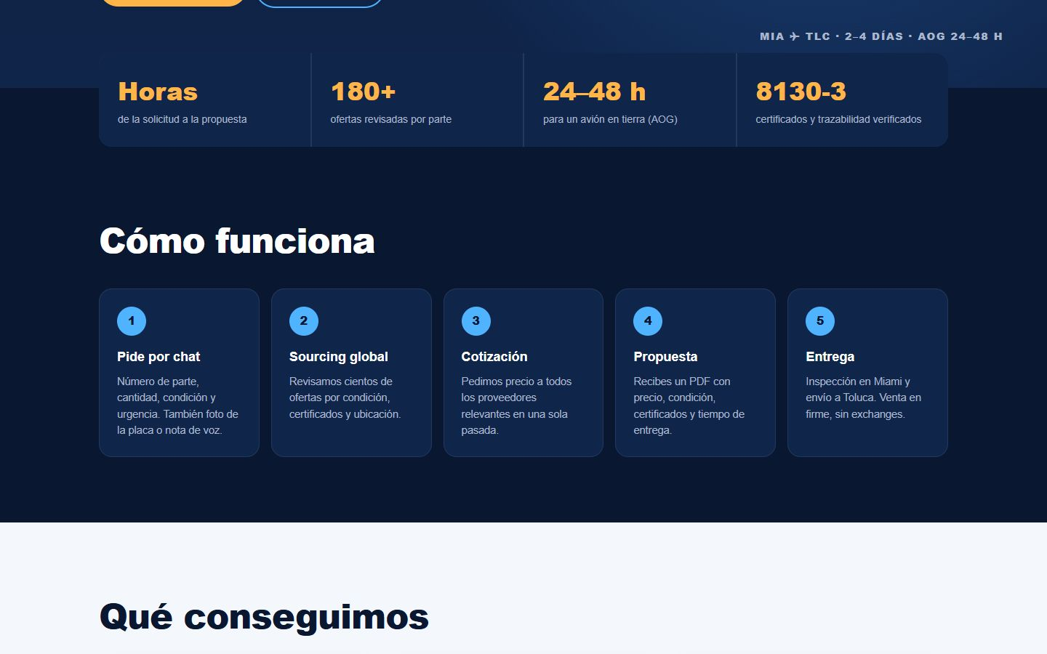
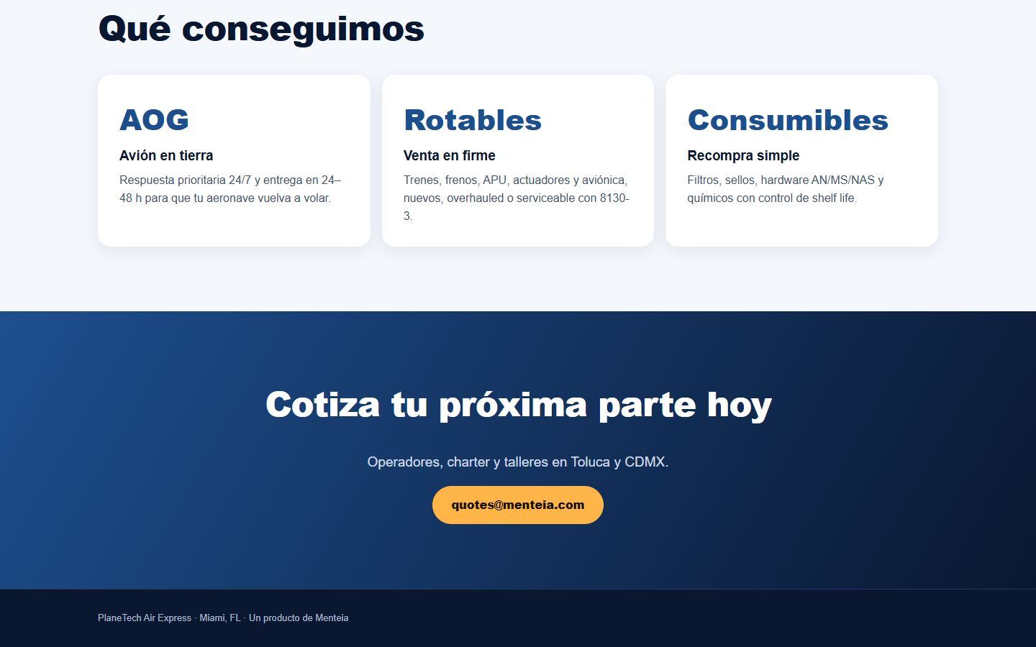
HTTPS://MENTEIA.COM/AEROEXPRESS/
The product, on screen

Slide 5
WHY WE WIN
The first to quote wins
Speed
Coverage
Hours, not days, from request to proposal.
More suppliers consulted for each part.
Traceability
The right hub
8130-3 and certificates verified in Miami.
Based in Miami, anchor customer in Toluca.

Slide 6
MARKET
Toluca: the business aviation hub
TAM US$600M
TAM
Replacement parts for business aviation, general aviation and MRO in Mexico
SAM
SAM US$60M
Toluca + Mexico City ecosystem: operators, charter and repair shops
SOM
SOM US$3.9M
~US$325k in sales per month within 24 months

Slide 7
BUSINESS MODEL
Margin on every transaction
AOG
ROTABLES
ROUTINE
30–50%
20–35%
15–25%
urgency margin, delivery in 24–48 h.
outright sale, no exchange.
consumables and hardware with repeat purchases.

Slide 8
TRACTION
Operating with the largest business aviation operator in LatAm
ALE
180+
8+
Min
active customer in Toluca
offers reviewed per search
suppliers per request
from request to RFQ sent
Agent in production since August 2026: chat intake, PartsBase, RFQs, reply reading and PDF proposals.

Slide 9
COMPETITION
Faster than a broker, more global than local suppliers
Alternative | What it offers | Our advantage
Local suppliers in Toluca | Limited inventory, import lead times | Access to the global market from Miami in hours
Traditional Miami brokers | Manual quoting by phone and email | AI agent: more suppliers, faster
Direct marketplace purchases | The customer searches and negotiates alone | Sourcing, verification and logistics handled
OEM distributors | List price, long lead times | Certified surplus/overhaul alternatives

Slide 10
GO-TO-MARKET
From ALE to the whole Toluca ecosystem
01
02
03
Anchor customer
AOG entry point
Certifications
ALE as a reference and recurring volume.
One solved emergency converts the customer.
ASA-100 and AS9120B for large MROs.

Slide 11
WHAT THE ROUND ACHIEVES
24-month roadmap
MONTHS 1–6
MONTHS 7–12
MONTHS 13–18
MONTHS 19–24
Commercial base
Repeat purchases
AOG 24/7
Scale
Document sales with ALE
ASA membership and Miami LLC
5 active customers in Toluca
Consumables program for MROs
ASA-100 certification
US$100k in sales per month
AOG on-call desk with high-turnover stock
Monterrey and Guadalajara
US$200k in sales per month
~US$325k in sales per month
AS9120B in progress
Central America

Slide 12
FINANCIALS
24-month financial projection
US$71k
Monthly revenue at month 24
US$857k
Annualized revenue (ARR) at month 24
Month 15
Monthly breakeven

Slide 13
THE OFFER
The round
US$475,000
USE OF FUNDS
Sales, marketing and customer success
48.2%
for 20.9% · 24 months of operation
Legal, compliance and tools
23.4%
Contingency (10%)
9.1%
PRE-MONEY
US$1,800,000
Product and engineering team
8.1%
POST-MONEY
US$2,275,000
Founders (time dedicated to the project)
7.7%
INSTRUMENT
Post-money SAFE
Infrastructure and AI compute
3.4%

Slide 14
TEAM
A team already running 9 AI products
RH
VD
FD
Rafael Herrera
Vladimir Díaz
Francisco D'Angelo
CEO / CFO
CTO
Head of Legal and Compliance
Strategy, finance and relationships with investors and corporate clients.
Architecture, AI and operation of Menteia's products in production.
Corporate structure, regulatory compliance and data protection.

Slide 15
Invest in PlaneTech Air Express
Mexico's business aviation needs parts faster. We are already quoting.
Rafael Herrera · CEO / CFO
Vladimir Díaz · CTO
menteia.com

