Slide 1
SEED ROUND · OCTOBER 2026
RosettaDMS
All your dealers. Any DMS. One language.
rosettadms.menteia.com
by MENTEIA
Notes:
RosettaDMS: Connects a car brand with all of its dealers whatever their DMS: through an API or an AI agent that operates it like a service advisor, a central brain that translates everything, an MCP server and voice with Allo.

Slide 2
THE PROBLEM
Hundreds of dealers, dozens of DMS, a blind brand
01
02
03
The brand
The dealer
The customer
Service, parts and inventory data late and in Excel.
Types everything twice and will not switch DMS.
Nobody answers and the part is not there.

Slide 3
THE SOLUTION
One language for every DMS
01
02
03
04
05
Connect
Translate
Think
Act
Expose
API or computer-use agent.
Rosetta Schema and VIN history.
JIT parts and quality alerts.
Writes bookings and reservations into the DMS.
MCP for agents and voice with Allo.

Slide 4
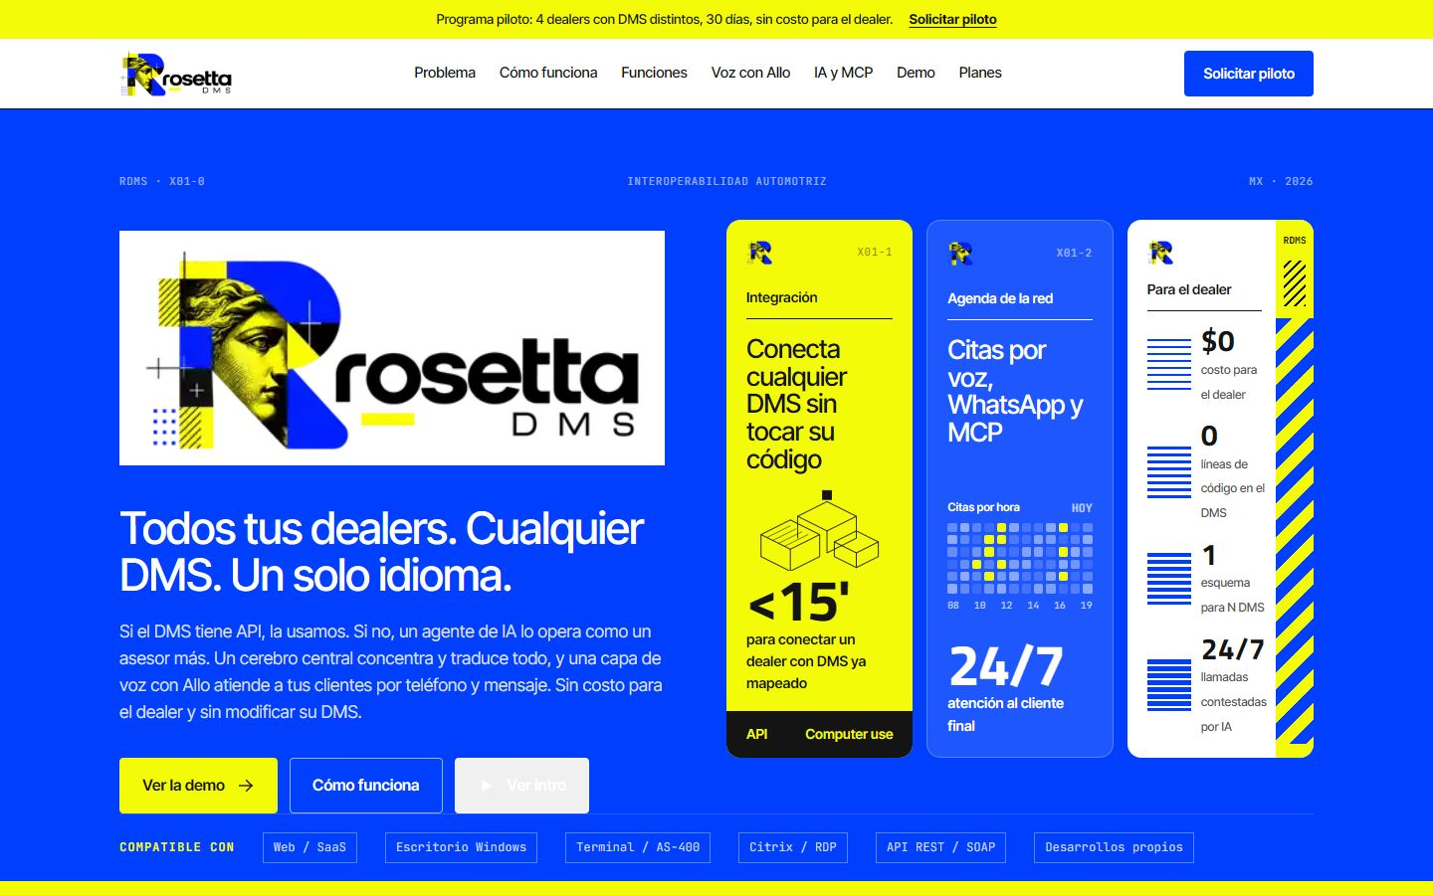
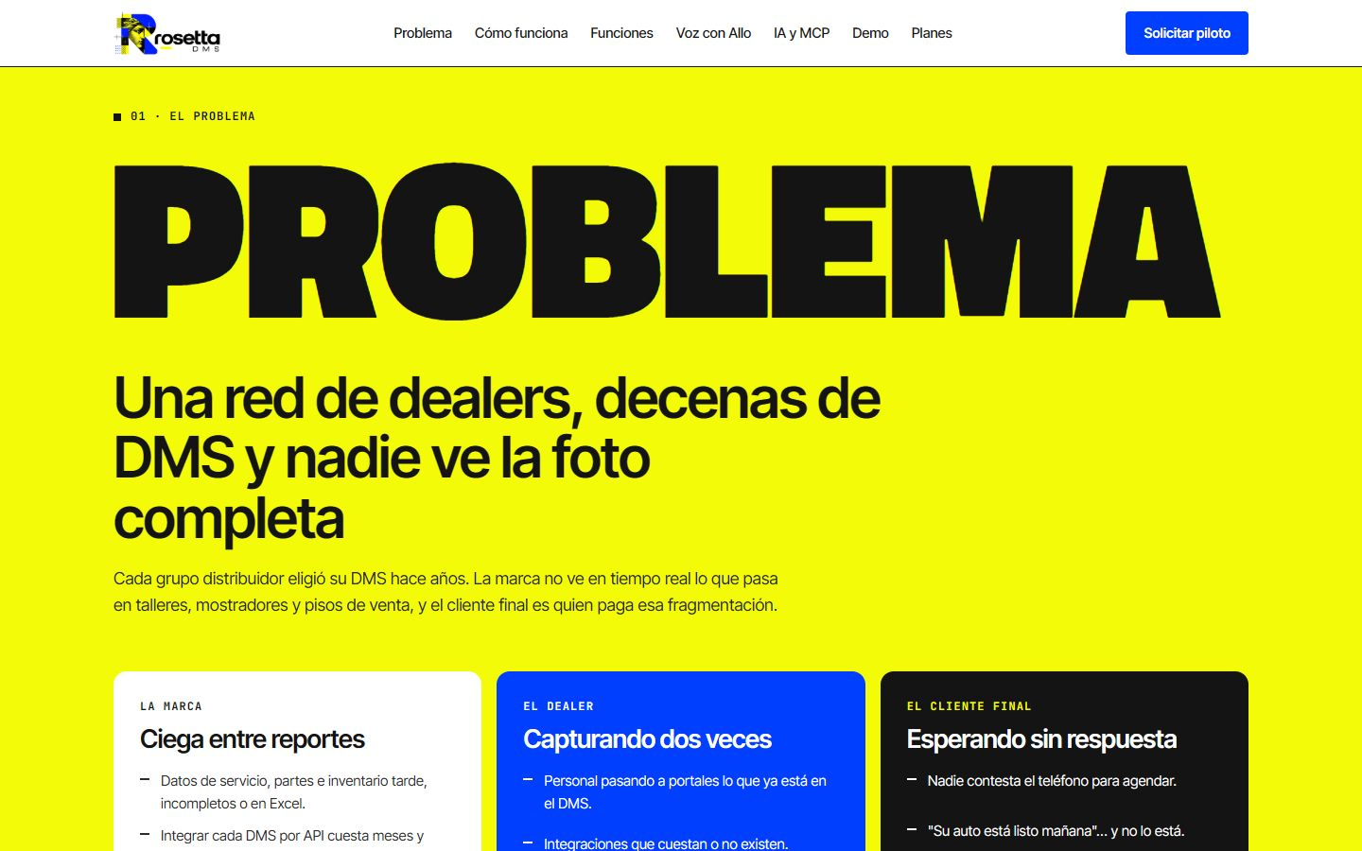
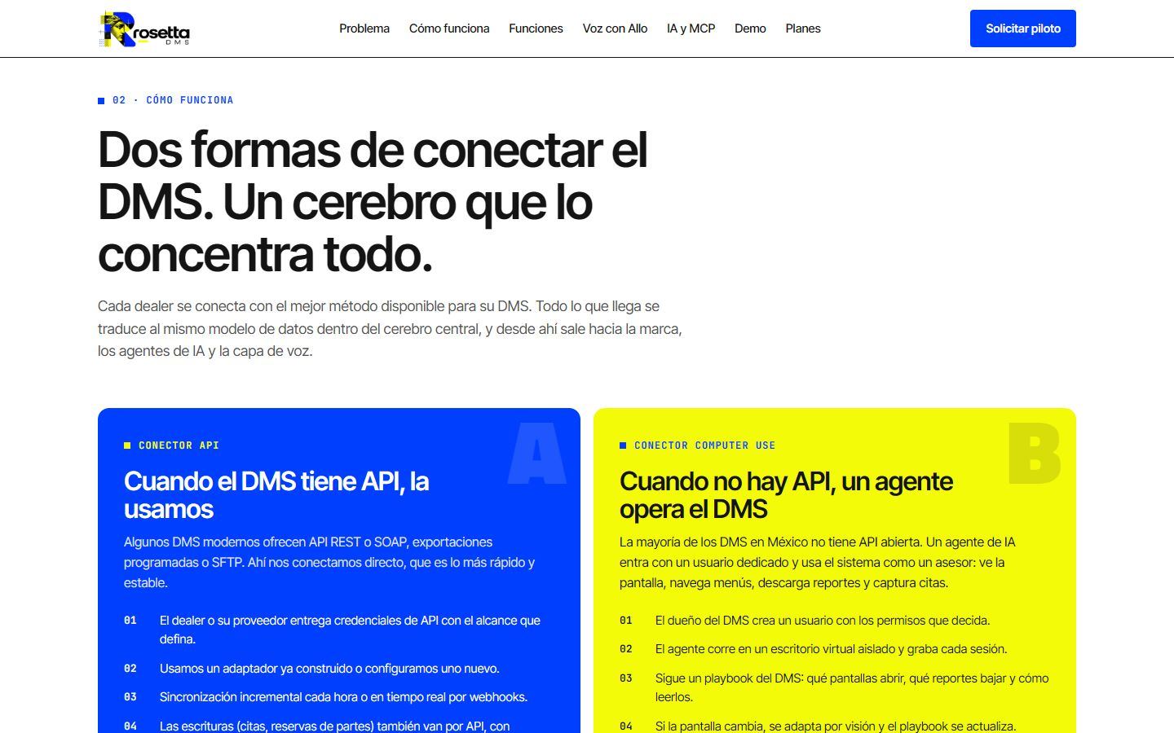
ROSETTADMS.MENTEIA.COM
The product, on screen

Slide 5
WHY WE WIN
Works where there is no API
No API needed
$0 for dealers
Runs desktop, AS-400 and Citrix DMS.
The brand pays per connected dealer.
Bidirectional
For agents
Reads and also books inside the DMS.
One MCP server for the whole network.

Slide 6
MARKET
2,800 dealers and no neutral integrator
TAM US$10M
TAM
2,800 dealers in Mexico × US$3.6k/year
SAM
SAM US$4M
Brands with 100+ dealers (~1,100 dealers)
SOM
SOM US$500k
~150 dealers from 1–2 brands

Slide 7
BUSINESS MODEL
The brand pays, the dealer doesn't
PILOT
NETWORK
ENTERPRISE
30 days
~US$300
Custom
4 dealers on 4 different DMS.
per dealer per month (proposed).
in the brand's cloud, with SSO and SLA.

Slide 8
TRACTION
Demo ready, seeking the first pilot
0
6
$0
pilots running
MCP tools defined
cost for the dealer
Clickable demo with 10 fictional dealers and 4 DMS types. No customers yet.

Slide 9
COMPETITION
What neither the DMS nor RPA does
Alternative | What it offers | Our advantage
DMS vendors (CDK, Reynolds, Quorum, local DMS) | Integration only with their own system | Unifies every DMS in the network into one schema
Automotive data integrators (e.g. Authenticom/DealerVault) | DMS data extraction, US-focused | Reads and writes, works without an API and exposes MCP for agents
Generic RPA (UiPath, Automation Anywhere) | Brittle bots, one project per customer | Reusable per-DMS playbooks and vision-based adaptation
Excel reports and brand portals | Late data and double entry | Daily or hourly data with no manual entry

Slide 10
GO-TO-MARKET
From 4 dealers to the whole network
01
02
03
Pilot
The brand
Reuse
4 dealers, 4 DMS, 30 days.
Funds it and recommends it to its network.
Every mapped DMS serves the next dealer.

Slide 11
WHAT THE ROUND ACHIEVES
24-month roadmap
MONTHS 1–6
MONTHS 7–12
MONTHS 13–18
MONTHS 19–24
First pilot
One brand's network
Second brand
Scale
Pilot with 1 brand or group (4 dealers, 4 DMS)
3 DMS mapped with a playbook
Convert the pilot into a contract
40 dealers connected
Voice with Allo in production
JIT parts ordering in use
Second brand
90 dealers connected
Quality alerts for the brand
~150 dealers connected
First customer outside Mexico
Breakeven

Slide 12
FINANCIALS
24-month financial projection
US$45k
Monthly revenue at month 24
US$540k
Annualized revenue (ARR) at month 24
Month 14
Monthly breakeven

Slide 13
THE OFFER
The round
US$425,000
USE OF FUNDS
Product and engineering team
31.4%
for 29.8% · 24 months of operation
Sales, marketing and customer success
26.5%
Founders (time dedicated to the project)
16.3%
PRE-MONEY
US$1,000,000
Infrastructure and AI compute
9.3%
POST-MONEY
US$1,425,000
Contingency (10%)
9.1%
INSTRUMENT
post-money SAFE
Legal, compliance and tools
7.5%

Slide 14
TEAM
A team already running 9 AI products
RH
VD
FD
Rafael Herrera
Vladimir Díaz
Francisco D'Angelo
CEO / CFO
CTO
Head of Legal and Compliance
Strategy, finance and relationships with investors and corporate clients.
Architecture, AI and operation of Menteia's products in production.
Corporate structure, regulatory compliance and data protection.

Slide 15
Invest in RosettaDMS
The demo exists. The round connects the first full network.
Rafael Herrera · CEO / CFO
Vladimir Díaz · CTO
rosettadms.menteia.com

